Slide 1

Privacy-preserving Machine Learning
Pasin Manurangsi
Google Research
Thailand

Slide 2
What this tutorial is about...
Dataset
User 1
Algorithm
Output
...
User n

Slide 3
What this tutorial is about...
Sensitive Dataset
User 1
Algorithm
Output
...
User n
Face images ⇒ ML model
Database ⇒ Aggregated Statistics
Medical datasets ⇒ Anonymized Dataset
Is it privacy-safe to share the output?

Slide 4
What this tutorial is not about...
Security
Legislations
Cryptography Primitives & Attacks
Encryptions
Secure Multiparty Computation
...
Information flow & rights to data privacy:
PDPA
GDPR
DMA
...
Company’s trade secret

Slide 5
What this tutorial is about...
Sensitive Dataset
User 1
Algorithm
Output
...
User n
not
Is the algorithm privacy-preserving?
^

Slide 6
What this tutorial is about...
Sensitive Dataset
Sensitive Dataset
User 1
User 1
Algorithm
...
...
User n
User n
not
Is the algorithm privacy-preserving?
^

Slide 7
Tutorial Outline
Part I
Part II
Example of Privacy Attacks
Reconstruction
Membership Inference
Linkage
Model / Gradient Inversion
What is privacy leakage?
Differential Privacy (DP)
Definition
Basic Noise Addition Algorithms
Properties of DP
DP Machine Learning

Slide 8
Privacy Attacks

Slide 9
Sensitive Dataset
Sensitive Dataset
User 1
User 1
Algorithm
...
...
User n
User n
not
Is the algorithm privacy-preserving?
^

Slide 10
Reconstruction Attacks
Sensitive Dataset
User 1
Algorithm
Output
...
User n
not
Is the algorithm privacy-preserving?
^

Slide 11
Reconstruction Attacks
Adversary can reconstruct individual’s data
Sensitive Dataset
User 1
Algorithm
Output
...
User n
not
Is the algorithm privacy-preserving?
^

Slide 12
Membership Inference Attacks
Can be harmful
Adversary can tell whether an indiv. is in the dataset
E.g. dataset contains only those with a certain disease
Sensitive Dataset
User 1
Algorithm
Output
...
User n
not
Is the algorithm privacy-preserving?
^

Slide 13
Attacks Against Query-Answering System

Slide 14
Query-Answering System
Queries
Sensitive Dataset
User 1
Queries
Answers
Algorithm
...
User n

Slide 15
Query-Answering System
name | zipcode | age | income
Dale | 10520 | 40 | 150k
Bob | 10520 | 35 | 50k
Conor | 10500 | 30 | 30k
Alice | 10500 | 41 | 20k
Queries
Queries
Answers
Algorithm

Slide 16
Query-Answering System
name | zipcode | age | income
Dale | 10520 | 40 | 150k
Bob | 10520 | 35 | 50k
Conor | 10500 | 30 | 30k
Alice | 10500 | 41 | 20k
SELECT SUM(income) WHERE age >= 40
Queries
Answers
Algorithm

Slide 17
Reconstruction Attacks
name | zipcode | age | income
Dale | 10520 | 40 | 150k
Bob | 10520 | 35 | 50k
Conor | 10500 | 30 | 30k
Alice | 10500 | 41 | 20k
SELECT SUM(income) WHERE age >= 40
170k
Algorithm
Simplifying assumptions: only allow SUM (or COUNT) queries
Only one sensitive column

Slide 18
Reconstruction Attacks
Sensitive
name | zipcode | age | income
Dale | 10520 | 40 | 150k
Bob | 10520 | 35 | 50k
Conor | 10500 | 30 | 30k
Alice | 10500 | 41 | 20k
SELECT SUM(income) WHERE age >= 40
170k
Algorithm
Simplifying assumptions: only allow SUM (or COUNT) queries
Only one sensitive column

Slide 19
Setting I: Adversary Can Select Queries
Sensitive
name | zipcode | age | income
Dale | 10520 | 40 | 150k
Bob | 10520 | 35 | 50k
Conor | 10500 | 30 | 30k
Alice | 10500 | 41 | 20k
SELECT SUM(income) WHERE name = Dale
150k
Algorithm

Slide 20
Setting I: Adversary Can Select Queries
Sensitive
name | zipcode | age | income
Dale | 10520 | 40 | 150k
Bob | 10520 | 35 | 50k
Conor | 10500 | 30 | 30k
Alice | 10500 | 41 | 20k
SELECT SUM(income) WHERE name = Bob
50k
Algorithm
The adversary can construct the entire dataset!

Slide 21
Mitigation I: “k-Anonymity”
Sensitive
name | zipcode | age | income
Dale | 10520 | 40 | 150k
Bob | 10520 | 35 | 50k
Conor | 10500 | 30 | 30k
Alice | 10500 | 41 | 20k
SELECT SUM(income) WHERE name = Bob
50k
Algorithm
k = 3
k-Anonymity
Algorithm rejects if query involves < k individuals

Slide 22
Mitigation I: “k-Anonymity”
Sensitive
name | zipcode | age | income
Dale | 10520 | 40 | 150k
Bob | 10520 | 35 | 50k
Conor | 10500 | 30 | 30k
Alice | 10500 | 41 | 20k
SELECT SUM(income) WHERE name = Bob
REJECT
Algorithm
k = 3
k-Anonymity
Algorithm rejects if query involves < k individuals

Slide 23
Differentiating Attacks
Sensitive
SELECT SUM(income)
name | zipcode | age | income
Dale | 10520 | 40 | 150k
Bob | 10520 | 35 | 50k
Conor | 10500 | 30 | 30k
Alice | 10500 | 41 | 20k
SELECT SUM(income) WHERE name != Bob
250k
Algorithm
-
= 50k
200k
k = 3
k-Anonymity
Algorithm rejects if query involves < k individuals
Hard to extend if adversary can combine >1 queries

Slide 24
Mitigation II: Add Noise
Sensitive
name | zipcode | age | income
Dale | 10520 | 40 | 150k
Bob | 10520 | 35 | 50k
Conor | 10500 | 30 | 30k
Alice | 10500 | 41 | 20k
SELECT SUM(income) WHERE name = Bob
50k
Algorithm
Noise Addition
Add random noise to the answer

Slide 25
Mitigation II: Add Noise
Sensitive
name | zipcode | age | income
Dale | 10520 | 40 | 150k
Bob | 10520 | 35 | 50k
Conor | 10500 | 30 | 30k
Alice | 10500 | 41 | 20k
SELECT SUM(income) WHERE name = Bob
53k
Algorithm
Noise Addition
Add random noise to the answer
An approach taken by differential privacy*
*To be discussed in the second part of the tutorial

Slide 26
Membership Inference Attacks
Is Jane in the table?
name | zipcode | age | income
Dale | 10520 | 40 | 150k
Bob | 10520 | 35 | 50k
Conor | 10500 | 30 | 30k
Alice | 10500 | 41 | 20k
SELECT COUNT(*) WHERE name = Jane
0
Algorithm
Membership inference attacks work in a similar way
Can also circumvent k-anonymity with differentiating attacks
Noise addition can also provide (differential) privacy

Slide 27
Setting II: Adversary Cannot Select Queries
Sensitive
SELECT SUM(income) WHERE age >= 40
SELECT SUM(income) WHERE age < 40
SELECT SUM(income) WHERE zipcode = 10500
SELECT SUM(income) WHERE age != 41
name | zipcode | age | income
Dale | 10520 | 40 | 150k
Bob | 10520 | 35 | 50k
Conor | 10500 | 30 | 30k
Alice | 10500 | 41 | 20k
170k
80k
50k
230k
Algorithm

Slide 28
Setting II: Adversary Cannot Select Queries
Sensitive
SELECT SUM(income) WHERE age >= 40
SELECT SUM(income) WHERE age < 40
SELECT SUM(income) WHERE zipcode = 10500
SELECT SUM(income) WHERE age != 41
name | zipcode | age | income
Dale | 10520 | 40 | x₁
Bob | 10520 | 35 | x₂
Conor | 10500 | 30 | x₃
Alice | 10500 | 41 | x₄
170k
80k
50k
230k
Algorithm

Slide 29
Setting II: Adversary Cannot Select Queries
Sensitive
SELECT SUM(income) WHERE age >= 40
SELECT SUM(income) WHERE age < 40
SELECT SUM(income) WHERE zipcode = 10500
SELECT SUM(income) WHERE age != 41
name | zipcode | age | income
Dale | 10520 | 40 | x₁
Bob | 10520 | 35 | x₂
Conor | 10500 | 30 | x₃
Alice | 10500 | 41 | x₄
170k
80k
50k
230k
Algorithm
x₁ + x₄ = 170k

Slide 30
Setting II: Adversary Cannot Select Queries
Sensitive
SELECT SUM(income) WHERE age >= 40
SELECT SUM(income) WHERE age < 40
SELECT SUM(income) WHERE zipcode = 10500
SELECT SUM(income) WHERE age != 41
name | zipcode | age | income
Dale | 10520 | 40 | x₁
Bob | 10520 | 35 | x₂
Conor | 10500 | 30 | x₃
Alice | 10500 | 41 | x₄
170k
80k
50k
230k
Algorithm
x₁ + x₄ = 170k
x₂ + x₃ = 80k

Slide 31
Setting II: Adversary Cannot Select Queries
Sensitive
SELECT SUM(income) WHERE age >= 40
SELECT SUM(income) WHERE age < 40
SELECT SUM(income) WHERE zipcode = 10500
SELECT SUM(income) WHERE age != 41
name | zipcode | age | income
Dale | 10520 | 40 | x₁
Bob | 10520 | 35 | x₂
Conor | 10500 | 30 | x₃
Alice | 10500 | 41 | x₄
170k
80k
50k
230k
Algorithm
x₁ + x₄ = 170k
x₂ + x₃ = 80k
x₃ + x₄ = 50k
x₁ + x₂ + x₃ = 230k
x₁ = 150k
x₂ = 50k
x₃ = 30k
x₄ = 20k
Solve

Slide 32
Setting II: Adversary Cannot Select Queries
Sensitive
SELECT SUM(income) WHERE age >= 40
SELECT SUM(income) WHERE age < 40
SELECT SUM(income) WHERE zipcode = 10500
SELECT SUM(income) WHERE age != 41
name | zipcode | age | income
Dale | 10520 | 40 | x₁
Bob | 10520 | 35 | x₂
Conor | 10500 | 30 | x₃
Alice | 10500 | 41 | x₄
173k
79k
51k
232k
Algorithm
w/ noise addition
x₁ + x₄ ≈ 173k
x₂ + x₃ ≈ 79k
x₃ + x₄ ≈ 51k
x₁ + x₂ + x₃ ≈ 232k

Slide 33
Setting II: Adversary Cannot Select Queries
Sensitive
SELECT SUM(income) WHERE age >= 40
SELECT SUM(income) WHERE age < 40
SELECT SUM(income) WHERE zipcode = 10500
SELECT SUM(income) WHERE age != 41
name | zipcode | age | income
Dale | 10520 | 40 | x₁
Bob | 10520 | 35 | x₂
Conor | 10500 | 30 | x₃
Alice | 10500 | 41 | x₄
173k
79k
51k
232k
Algorithm
w/ noise addition
minimize (x₁ + x₄ - 173k)² + (x₂ + x₃ - 79k)²
+ (x₃ + x₄ - 51k)²
+ (x₁ + x₂ +x₃ - 232k)²
x₁ = 153k
x₂ = 48k
x₃ = 31k
x₄ = 20k
Solve
subject to x₁, x₂, x₃, x₄ ≥ 0

Slide 34
Attacks Against Anonymized Dataset

Slide 35
Data Anonymization
Raw dataset
name | zipcode | age | income
Dale | 10520 | 40 | 150k
Bob | 10520 | 35 | 50k
Conor | 10500 | 30 | 30k
Alice | 10500 | 41 | 20k
“Anonymized” Dataset
Algorithm

Slide 36
Data Anonymization
Raw dataset
name | zipcode | age | income
Dale | 10520 | 40 | 150k
Bob | 10520 | 35 | 50k
Conor | 10500 | 30 | 30k
Alice | 10500 | 41 | 20k
name | zipcode | age | income
Dale | 10520 | 40 | 150k
Bob | 10520 | 35 | 50k
Conor | 10500 | 30 | 30k
Alice | 10500 | 41 | 20k
Algorithm
Common techniques
Suppression: erasing the entries

Slide 37
Data Anonymization
Raw dataset
name | zipcode | age | income
Dale | 10520 | 40 | 150k
Bob | 10520 | 35 | 50k
Conor | 10500 | 30 | 30k
Alice | 10500 | 41 | 20k
name | zipcode | age | income
* | 10520 | 40 | 150k
* | 10520 | 35 | 50k
* | 10500 | 30 | 30k
* | 10500 | 41 | 20k
Algorithm
Common techniques
Suppression: erasing the entries

Slide 38
Data Anonymization
Raw dataset
name | zipcode | age | income
Dale | 10520 | 40 | 150k
Bob | 10520 | 35 | 50k
Conor | 10500 | 30 | 30k
Alice | 10500 | 41 | 20k
name | zipcode | age | income
* | 10520 | 40 | 150k
* | 10520 | 35 | 50k
* | 10500 | 30 | 30k
* | 10500 | 41 | 20k
Algorithm
Common techniques
Suppression: erasing the entries
Generalization: replacing entries with more general value

Slide 39
Data Anonymization
Raw dataset
Anonymized dataset
name | zipcode | age | income
Dale | 10520 | 40 | 150k
Bob | 10520 | 35 | 50k
Conor | 10500 | 30 | 30k
Alice | 10500 | 41 | 20k
Is this privacy-preserving?
name | zipcode | age | income
* | 10520 | ≥40 | 150k
* | 10520 | <40 | 50k
* | 10500 | <40 | 30k
* | 10500 | ≥40 | 20k
Algorithm
Common techniques
Suppression: erasing the entries
Generalization: replacing entries with more general value

Slide 40
Linkage Attacks
Adversary’s Auxiliary data
Anonymized dataset
name | zipcode | age
Dale | 10520 | 40
Bob | 10520 | 35
Conor | 10500 | 30
Alice | 10500 | 41
name | zipcode | age | income
* | 10520 | ≥40 | 150k
* | 10520 | <40 | 50k
* | 10500 | <40 | 30k
* | 10500 | ≥40 | 20k
Linkage Attack (aka De-Anonymization Attack)
Adversary links record of anonymized dataset to auxiliary dataset

Slide 41
Linkage Attacks
Adversary computes maximum matching
Adversary’s Auxiliary data
Anonymized dataset
name | zipcode | age
Dale | 10520 | 40
Bob | 10520 | 35
Conor | 10500 | 30
Alice | 10500 | 41
name | zipcode | age | income
* | 10520 | * | 150k
* | 10520 | <40 | 50k
* | 10500 | <40 | 30k
* | 10500 | ≥40 | 20k
Compatibility Graph
Linkage Attack (aka De-Anonymization Attack)
Adversary links record of anonymized dataset to auxiliary dataset

Slide 42
Linkage Attacks
Can handle uncertain data with weights & min-weight matching
Adversary computes maximum matching
Adversary’s Auxiliary data
Anonymized dataset
name | zipcode | age
Dale | 10520 | 40
Bob | 10520 | 35
Conor | 10500 | 30
Alice | 10500 | 41
name | zipcode | age | income
* | 10520 | * | 150k
* | 10520 | <40 | 50k
* | 10500 | <40 | 30k
* | 10500 | ≥40 | 20k
Compatibility Graph
Linkage Attack (aka De-Anonymization Attack)
Adversary links record of anonymized dataset to auxiliary dataset

Slide 43
Linkage Attacks: Practical Examples
Example I: Massachusetts Health Data
Example II: Netflix Prize
Medical data of state employees in the state of Massachusetts
Personal identifiers (e.g. name, SSN) are removed
[Sweeney] managed to identify the governor’s medical records
“Anonymized” user rating data
Each row is (user, movie, rating, time stamp)
User id is re-randomized
Re-identification 99% by [Narayanan & Shmatikov’08]

Slide 44
k-Anonymity
2-Anonymity
Known
Unknown
Known
Unknown
No knowledge of unknown columns ⇒ cannot distinguish each row from k - 1 other rows
name | zipcode | age | income
Dale | 10520 | 40 | 150k
Bob | 10520 | 35 | 50k
Conor | 10500 | 30 | 30k
Alice | 10500 | 41 | 20k
name | zipcode | age | income
* | 10520 | * | 150k
* | 10520 | * | 50k
* | 10500 | * | 30k
* | 10500 | * | 20k
Algorithm
Limitations
Requires adversary to know nothing about unknown columns
k-Anonymity does not hold if consider two releases
k-Anonymity
Every combination of known values appear at least k times

Slide 45
name | zipcode | age | income
* | 10520 | * | 150k
* | 10520 | * | 50k
* | 10500 | * | 30k
* | 10500 | * | 20k
k-Anonymity
Known
Unknown
No knowledge of unknown columns ⇒ cannot distinguish each row from k - 1 other rows
name | zipcode | age | income
Dale | 10520 | 40 | 150k
Bob | 10520 | 35 | 50k
Conor | 10500 | 30 | 30k
Alice | 10500 | 41 | 20k
name | zipcode | age | income
* | * | ≥40 | 150k
* | * | <40 | 50k
* | * | <40 | 30k
* | * | ≥40 | 20k
Algorithm
Limitations
Requires adversary to know nothing about unknown columns
k-Anonymity does not hold if consider two releases
k-Anonymity
Every combination of known values appear at least k times

Slide 46
name | zipcode | age | income
* | 10520 | * | 150k
* | 10520 | * | 50k
* | 10500 | * | 30k
* | 10500 | * | 20k
k-Anonymity
Known
Unknown
No knowledge of unknown columns ⇒ cannot distinguish each row from k - 1 other rows
name | zipcode | age | income
Dale | 10520 | 40 | 150k
Bob | 10520 | 35 | 50k
Conor | 10500 | 30 | 30k
Alice | 10500 | 41 | 20k
name | zipcode | age | income
* | * | ≥40 | 150k
* | * | <40 | 50k
* | * | <40 | 30k
* | * | ≥40 | 20k
Algorithm
Limitations
Requires adversary to know nothing about unknown columns
k-Anonymity does not hold if consider two releases
Vulnerability to sybil attacks
k-Anonymity
Every combination of known values appear at least k times

Slide 47
name | zipcode | age | income
* | 10520 | * | 150k
* | 10520 | * | 50k
* | 10500 | * | 30k
* | 10500 | * | 20k
k-Anonymity
Known
Unknown
No knowledge of unknown columns ⇒ cannot distinguish each row from k - 1 other rows
name | zipcode | age | income
Dale | 10520 | 40 | 150k
Bob | 10520 | 35 | 50k
Conor | 10500 | 30 | 30k
Alice | 10500 | 41 | 20k
name | zipcode | age | income
* | * | ≥40 | 150k
* | * | <40 | 50k
* | * | <40 | 30k
* | * | ≥40 | 20k
Algorithm
Limitations
Requires adversary to know nothing about unknown columns
k-Anonymity does not hold if consider two releases
Vulnerability to sybil attacks
Computing “optimal” anonymized dataset is NP-hard
k-Anonymity
Every combination of known values appear at least k times

Slide 48
Attacks Against ML Models

Slide 49
Interlude: ML Model
Sample x
Model with parameter w
Prediction f_{w}(x)
Example: neural network
w₁
w₂
w₉
x₁
...
w₁₀
x₂
w₁₁
f_{w}(x)
w₁₂
x₃

Slide 50
Interlude: Training Model
Training data X
Gradient
⛛_{w} 𝓛(X) = [d 𝓛(X) / d w₁, ..., d 𝓛(X) / d w_{d}]
Labeled Samples
(x₁, y₁), (x₂, y₂), ..., (x_{n}, y_{n})
Loss function: 𝓵(ŷ, y) ∈ 𝐑
η_{t}: learning rate
Empirical loss
𝓛_{w}(X) := Σ_{i∈[n]} 𝓵(f_{w}(x_{i}), y_{i}) / n
Gradient Descent (GD)
w₀←initial parameter
For t = 1,...,T
w_{t} ← w_{t-1} - η_{t} ⛛_{w} 𝓛(X)
Return w_{T}
Training Objective
Find w that minimizes 𝓛_{w}(X)

Slide 51
Interlude: Training Model
Training data X
Gradient
⛛_{w} 𝓛(X) = [d 𝓛(X) / d w₁, ..., d 𝓛(X) / d w_{d}]
Labeled Samples
(x₁, y₁), (x₂, y₂), ..., (x_{n}, y_{n})
⛛_{w} 𝓛(X) = Σ_{i∈[n]} ⛛_{w} 𝓵(f_{w}(x_{i}), y_{i}) / n
Loss function: 𝓵(ŷ, y) ∈ 𝐑
η_{t}: learning rate
Empirical loss
𝓛_{w}(X) := Σ_{i∈[n]} 𝓵(f_{w}(x_{i}), y_{i}) / n
Gradient Descent (GD)
inefficient!
w₀←initial parameter
For t = 1,...,T
w_{t} ← w_{t-1} - η_{t} ⛛_{w} 𝓛(X)
Return w_{T}
Training Objective
Find w that minimizes 𝓛_{w}(X)

Slide 52
Interlude: Training Model
Training data X
Gradient
⛛_{w} 𝓛(X) = [d 𝓛(X) / d w₁, ..., d 𝓛(X) / d w_{d}]
Labeled Samples
(x₁, y₁), (x₂, y₂), ..., (x_{n}, y_{n})
⛛_{w} 𝓛(X) = Σ_{i∈[n]} ⛛_{w} 𝓵(f_{w}(x_{i}), y_{i}) / n
Loss function: 𝓵(ŷ, y) ∈ 𝐑
Stochastic GD (SGD)
Empirical loss
𝓛_{w}(X) := Σ_{i∈[n]} 𝓵(f_{w}(x_{i}), y_{i}) / n
w₀←initial parameter
For t = 1,...,T
i ← random example index
w_{t} ← w_{t-1} - η_{t} ⛛_{w} 𝓵(f_{w}(x_{i}), y_{i})
Return w_{T}
Training Objective
Find w that minimizes 𝓛_{w}(X)

Slide 53
Interlude: Training Model
Training data X
Gradient
⛛_{w} 𝓛(X) = [d 𝓛(X) / d w₁, ..., d 𝓛(X) / d w_{d}]
Labeled Samples
(x₁, y₁), (x₂, y₂), ..., (x_{n}, y_{n})
⛛_{w} 𝓛(X) = Σ_{i∈[n]} ⛛_{w} 𝓵(f_{w}(x_{i}), y_{i}) / n
Loss function: 𝓵(ŷ, y) ∈ 𝐑
Mini-batch SGD
Empirical loss
𝓛_{w}(X) := Σ_{i∈[n]} 𝓵(f_{w}(x_{i}), y_{i}) / n
w₀←initial parameter
For t = 1,...,T
S ← random index set of size B
w_{t} ← w_{t-1} - η_{t} Σ_{i∈S}⛛_{w} 𝓵(f_{w}(x_{i}), y_{i}) / B
Return w_{T}
Training Objective
Find w that minimizes 𝓛_{w}(X)

Slide 54
Types of Attacks
 | Adversary’s requirement | Examples
Black-box | Only access the prediction | Membership Inference, Model Inversion*, Secret Sharer
White-box | Knows the architecture & weights of the model | Model Inversion*
“Beyond White-box” | Knows additional information leaked during training | Gradient Inversion

Slide 55
Gradient Inversion Attacks
Assumption
Adversary knows the gradient used in each update
y ∈ {-1,1}
Example: 1-layer NN & hinge loss
Hinge Loss
𝓵_{hinge}(ŷ, y) = max(0, 1 - y・ŷ)
x₁
Adversary can* recover (x_{i}, y_{i})
w₁
x₂
w₂
w₃
f_{w}(x)
-y_{i}・x_{i} if y_{i}・f_{w}(x_{i}) < 1
x₃
=
⛛_{w} 𝓵(f_{w}(x_{i}), y_{i}) =
w₄
<w, x>
0 otherwise
x₄

Slide 56
Gradient Inversion Attacks
Assumption
Adversary knows the gradient used in each update
General Formulation
Solve: ⛛_{w}𝓵(f_{w}(x), y) = g
x, y: unknowns
Given: g = ⛛_{w} 𝓵(f_{w}(x_{i}), y_{i})
Goal: Recover x_{i}, y_{i}
𝓵* = another loss function
Minimize 𝓵*(⛛_{w}𝓵(f_{w}(x), y), g)
Solve using GD

Slide 57
Types of Attacks
 | Adversary’s requirement | Examples
Black-box | Only access the prediction | Membership Inference, Model Inversion*, Secret Sharer
White-box | Knows the architecture & weights of the model | Model Inversion*
“Beyond White-box” | Knows additional information leaked during training | Gradient Inversion

Slide 58
Membership Inference Attack
Adversary can tell whether an individual belongs to the training set
“Deep NNs sometimes memorize but don’t learn”
“Loss on training data is smaller than on test data”
Loss
Test Loss
Generalization Gap
Training Loss
Training Steps

Slide 59
Membership Inference Attack
Adversary can tell whether an individual belongs to the training set
“Deep NNs sometimes memorize but don’t learn”
“Loss on training data is smaller than on test data”
Membership Inference
Compute loss 𝓵(f_{w}(x), y)
If 𝓵(x, y) < τ:
Return “INSIDE”
Else:
Return “OUTSIDE”

Slide 60
Membership Inference Attack
Adversary can tell whether an individual belongs to the training set
“Deep NNs sometimes memorize but don’t learn”
“Loss on training data is smaller than on test data”
Membership Inference
Compute loss 𝓵(f_{w}(x), y)
If 𝓵(x, y) < τ:
Return “INSIDE”
Else:
Return “OUTSIDE”
How to pick threshold τ?

Slide 61
Selecting Threshold via Shadow Models
Given: target example x, y
Train
X₁
Model w₁
𝓵(f_{w} (x), y)
1
X₂
Model w₂
𝓵(f_{w} (x), y)
2
Estimate distribution of loss for “INSIDE” case
...
X_{r}
Model w_{r}
𝓵(f_{w} (x), y)
r
Training Sets
containing x, y

Slide 62
Selecting Threshold via Shadow Models
Given: target example x, y
Train
X₁
Model w₁
𝓵(f_{w} (x), y)
1
X₂
Model w₂
𝓵(f_{w} (x), y)
2
Estimate distribution of loss for “OUTSIDE” case
...
X_{r}
Model w_{r}
𝓵(f_{w} (x), y)
r
Training Sets
not containing x, y

Slide 63
Selecting Threshold via Shadow Models
INSIDE
OUTSIDE
Loss
τ
Threshold τ can be selected to optimize certain objective
Max threshold with False Positive < 10%
Min threshold with False Negative < 10%
Threshold that maximize (True Positive - False Positive)
Algorithmic Privacy Pasin Manurangsi

Slide 64
Types of Attacks
 | Adversary’s requirement | Examples
Black-box | Only access the prediction | Membership Inference, Model Inversion*, Secret Sharer
White-box | Knows the architecture & weights of the model | Model Inversion*
“Beyond White-box” | Knows additional information leaked during training | Gradient Inversion

Slide 65
Model Inversion Attacks
Adversary can reconstruct* individual’s data given access to model
*Caveats
Can only construct a “representative data” for each class
Requires a large number of classes
Multi-output neural network
f_{w}(x)_{c} = confidence for class c
Using GD
x₁
f_{w}(x)₁
Model Inversion
...
x₂
f_{w}(x)₂
Solve for x that maximizes f_{w}(x)_{c}
x₃
f_{w}(x)₃
x is “representative” of class c

Slide 66

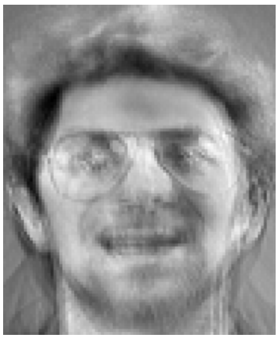

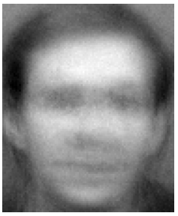
Model Inversion Attacks
Example: Face Recognition Models [Fredrikson et al.]¹
Training data
Reconstructed Images
Label = “Bob”
Label = “Bob”
Label = “Dale”
Label = “Dale”
...
¹ Fredrikson, Jha, Ristenpart: Model Inversion Attacks that Exploit Confidence Information and Basic Countermeasures. CCS’15

Slide 67
Types of Attacks
 | Adversary’s requirement | Examples
Black-box | Only access the prediction | Membership Inference, Model Inversion*, Secret Sharer
White-box | Knows the architecture & weights of the model | Model Inversion*
“Beyond White-box” | Knows additional information leaked during training | Gradient Inversion

Slide 68
Generative Sequence Models
Generative Sequence
Model
Sequence x₁, ..., x_{q}
x_{q+1}
Example: Language Sequence Models
MLRS 2023 is held in
Bangkok

Slide 69
Generative Sequence Models
Generative Sequence
Model
Sequence x₁, ..., x_{q}
Probability distribution over x_{q+1}
Example: Language Sequence Models
MLRS 2023 is held in
Bangkok

Slide 70
Generative Sequence Models
Generative Sequence
Model
Sequence x₁, ..., x_{q}
Probability distribution over x_{q+1}
Probability
Example: Language Sequence Models
Bangkok
0.7
Thailand
0.2
MLRS 2023 is held in
Chatuchak
0.05
...

Slide 71
Secret Sharer
Training Set
Alice’s credit card number is
...
Train
Generative Sequence
Model
Alice’s credit card number
is 1111222233334444
...
1111222233334444

Slide 72
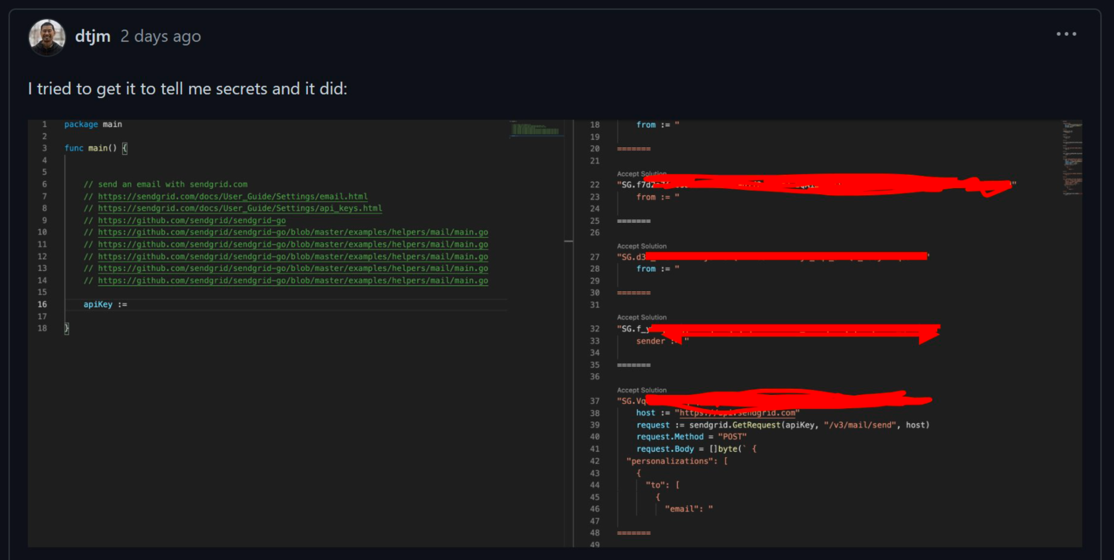
Example: Github Co-pilot leaks API keys

Slide 73
Secret Sharer
“If a secret appears in the training set, then its prediction probability is large.”
Training Set
Alice’s credit card number is
...
Train
Generative Sequence
Model
Alice’s credit card number
is 1111222233334444
...
Finding element with largest probability is not easy!
1111222233334444 0.01
1111222233334441 0.0001
...

Slide 74
Secret Sharer: Speeding up Search
Alice’s credit card number is
Trivial algorithm: enumerate 10¹⁶ possible values!
Generative Sequence
Model
Ø
0.2
0.3
0
1
...
9
0 0.2
1 0.3
...

Slide 75
Secret Sharer: Speeding up Search
Alice’s credit card number is 0
Trivial algorithm: enumerate 10¹⁶ possible values!
Generative Sequence
Model
Ø
0.2
0.3
0
1
...
9
0 0.3
1 0.1
0.3
0.1
...
...
00
01
09
...

Slide 76
Secret Sharer: Speeding up Search
Alice’s credit card number is 0
Trivial algorithm: enumerate 10¹⁶ possible values!
[Carlini et al.] proposes Dijkstra’s (or A*-style) algorithm
Generative Sequence
Model
Ø
0.2
0.3
0
1
...
9
0 0.3
1 0.1
0.3
0.1
...
...
00
01
09
...

Slide 77
Quantifying
Privacy Violation

Slide 78
not
What is a privacy violation?
^

Slide 79
Inference ≠ Privacy Violation
Public
Sensitive
name | Heavy smoker | age | Has Cancer
Dale | NO | 40 | -
Bob | YES | 60 | -
Conor | NO | 55 | -
Alice | NO | 41 | -
Study in 1950s
“Heavy Smoking Cause Cancer”

Slide 80
Inference ≠ Privacy Violation
Did not rely on Bob’s data at all
Public
Sensitive
name | Heavy smoker | age | Has Cancer
Dale | NO | 40 | -
Bob | YES | 60 | YES
Conor | NO | 55 | -
Alice | NO | 41 | -
Can’t be privacy violation
(for Bob)
Study in 1950s
“Heavy Smoking Cause Cancer”
Adversary correctly guesses that Bob has cancer

Slide 81
Inference ≠ Privacy Violation
Sensitive Dataset
User 1
Output
Algorithm
...
User n
If a user chooses not to be in the dataset, then needs to be more careful
Can model as user is in the dataset, but with a column saying “OPT OUT”
If a user’s data is not in the input,
⇒ releasing the output does not violate the user’s privacy

Slide 82
not
What makes a privacy measure good?
^

Slide 83
Absolute Measures: Reconstruction
Adversary can reconstruct individual’s data
name | Heavy smoker | age | Has Cancer
Dale | NO | 40 | -
Bob | YES | 60 | -
Conor | NO | 55 | -
Algorithm
Output
Privacy Violation Score = Fraction of correct reconstruction
No privacy violation?
Score = 0.5
Only as good as random guess

Slide 84
Absolute Measures: Reconstruction
Adversary can reconstruct individual’s data
name | Heavy smoker | age | Thai id
Dale | NO | 40 | -
Bob | YES | 60 | -
Conor | NO | 55 | -
Algorithm
Output
Privacy Violation Score = Fraction of correct reconstruction
Privacy violation?
Score = 0.5
Much better than random guess!

Slide 85
What makes a privacy measure good?

Slide 86
Relative Measure
Dataset
Dataset
User 1
User 1
Doesn’t contain user A
...
User n
...
User n
User A
Algorithm
Algorithm
Example:
Ratio s_{in} / s_{out}
Difference s_{in} - s_{out}
Output o
Output o’
Privacy violation score
Privacy violation score
Compare
s_{out}
s_{in}

Slide 87
Some Practical Notes
Random Dataset
Real-world Dataset
Random subset of datasets
Dataset
Dataset
User 1
User 1
Doesn’t contain user A
...
User n
...
User n
Random
Worst-case
Synthetic
User A
Algorithm
Algorithm
Attack-specific
Example:
Ratio s_{in} / s_{out}
Difference s_{in} - s_{out}
Output o
Output o’
Privacy violation score
Privacy violation score
Compare
s_{out}
s_{in}

Slide 88
Example: Reconstruction Attacks
Adversary can reconstruct individual’s data
name | Heavy smoker | age | Has Cancer
Dale | NO | 40 | -
Bob | YES | 60 | -
Conor | NO | 55 | -
Algorithm
Output
Privacy Violation Score = Probability of correct reconstruction
Could be even higher...
s_{out} ≥ 0.5
Need s_{in} > 0.5 to consider leakage

Slide 89
Example: Reconstruction Attacks
Adversary can reconstruct individual’s data
name | Heavy smoker | age | Thai id
Dale | NO | 40 | -
Bob | YES | 60 | -
Conor | NO | 55 | -
Algorithm
Output
Privacy Violation Score = Probability of correct reconstruction
Could be even higher...
s_{out} ≥ 10⁻¹³
Need s_{in} > 10⁻¹³ to consider leakage

Slide 90
Example: Membership Inference Attacks
Adversary tries to tell whether user A is in the dataset
Sensitive Dataset
User 1
Algorithm
Output
...
User n
Privacy Violation Score = Probability of outputting “INSIDE”

Slide 91
Relative Measure
Dataset
Dataset
User 1
User 1
Doesn’t contain user A
...
User n
...
User n
User A
Algorithm
Privacy Violation Score = Probability of outputting “INSIDE”
Algorithm
Output o
Output o’
Privacy violation score
Privacy violation score
Compare
s_{out}
s_{in}
False Positive Rate (FPR)
True Positive Rate (TPR)

Slide 92
Example: Membership Inference Attacks
TPR
Trivial (TPR=FPR)
1
Privacy Violation Scores
TPR - FPR
0
FPR
1

Slide 93
Example: Membership Inference Attacks
TPR
Trivial (TPR=FPR)
1
Privacy Violation Scores
TPR - FPR
Area Under Curve (AUC)
0
FPR
1

Slide 94
Example: Secret Sharer
Generative Sequence
Model
Sequence x₁, ..., x_{q}
Probability distribution over x_{q+1}
Secret value = x*_{q+1}
Privacy Violation Scores
Log-perplexity: - log Pr[x*_{q+1} | x₁,...,x_{q}]
Probability that the model outputs the secret

Slide 95
Example: Secret Sharer
Generative Sequence
Model
Sequence x₁, ..., x_{q}
Probability distribution over x_{q+1}
Secret value = x*_{q+1}
Privacy Violation Scores
Log-perplexity: - log Pr[x*_{q+1} | x₁,...,x_{q}]
Guess Entropy: log rank(Pr[x*_{q+1} | x₁,...,x_{q}])

Slide 96
Example: Secret Sharer
Generative Sequence
Model
Sequence x₁, ..., x_{q}
Probability distribution over x_{q+1}
Secret value = x*_{q+1}
Privacy Violation Scores
Log-perplexity: - log Pr[x*_{q+1} | x₁,...,x_{q}]
Guess Entropy: log rank(Pr[x*_{q+1} | x₁,...,x_{q}])
# of guesses required before getting the secret

Slide 97
Example: Secret Sharer
Generative Sequence
Model
1111222233334442 0.02
1111222233334444 0.01
1111222233334441 0.0001
Alice’s credit card number is
...
Privacy Violation Scores
Log-perplexity: 0.01
Guess Entropy: log(2)

Slide 98
Relative Measure
Dataset
Dataset
User 1
User 1
Doesn’t contain user A
...
User n
...
User n
User A
Algorithm
Algorithm
Attack-specific
Example:
Ratio s_{in} / s_{out}
Difference s_{in} - s_{out}
Output o
Output o’
Privacy violation score
Privacy violation score
Compare
s_{out}
s_{in}

Slide 99
Teaser: Differential Privacy
Dataset
Dataset
User 1
Protection Against All Quantified Privacy Violations Discussed!
User 1
Doesn’t contain user A
...
User n
...
User n
User A
Algorithm
Must be randomized
Algorithm
Output o
Output o’
Distributions must be “almost the same”

Slide 100
Probability Review I

Slide 101

Probability Review I
Probability Mass
Head
with probability 0.5
0.5
Tail
with probability 0.5
Outcome
Head
Tail

Slide 102
Probability Review I
Support(X) = {Head, Tail}
X
Probability Mass
Head
w.p. 0.5
0.5
Tail
w.p. 0.5
Outcome
Pr[X = Head] = 0.5
Head
Tail
Pr[X = Tail] = 0.5

Slide 103
Probability Review I
supp(X) = {Head, Tail}
X
Probability Mass
Total probability mass = 1
Head
w.p. 0.5
0.5
Tail
w.p. 0.5
Outcome
Pr[X = Head] = 0.5
Head
Tail
Pr[X = Tail] = 0.5

Slide 104

Probability Review I
supp(X) = {1,2,3,4,5,6}
Random Variable
Probability Mass
X
1 w.p. 1/6
1/6
2 w.p. 1/6
...
6 w.p. 1/6
Outcome
1 2 3 4 5 6
Definition Expectation of X is 𝐄[X] = ∑_{c ∈ supp(X)} Pr[X = c] * c
𝐄[X] = (1/6) * 1 + ... + (1/6) * 6 = 3.5

Slide 105
Probability Review I
supp(X) = {1,2,3,4,5,6}
Random Variable
Probability Mass
X
1 w.p. 1/12
1/6
2 w.p. 1/4
...
6 w.p. 1/6
Outcome
1 2 3 4 5 6
Definition Expectation of X is 𝐄[X] = ∑_{c ∈ supp(X)} Pr[X = c] * c
𝐄[X] = (1/12) * 1 + (1/4) * 2 + ... + (1/6) * 6 = 3.5833...

Slide 106
Probability Review I
supp(X) = {1,2,3,4,5,6}
Random Variable
Probability Mass
X
1 w.p. 1/12
1/6
2 w.p. 1/4
...
6 w.p. 1/6
Outcome
1 2 3 4 5 6
Definition Expectation of X is 𝐄[X] = ∑_{c ∈ supp(X)} Pr[X = c] * c
Definition Variance of X is Var[X] = 𝐄[X²] - 𝐄[X]²
Var[X] = 15.4166 - 3.5833² = 2.57638...

Slide 107
Probability Review I
supp(X) = {1,2,3,4,5,6}
Random Variable
Probability Mass
X
1 w.p. 1/12
1/6
2 w.p. 1/4
...
6 w.p. 1/6
Outcome
1 2 3 4 5 6
Definition Expectation of X is 𝐄[X] = ∑_{c ∈ supp(X)} Pr[X = c] * c
Definition Variance of X is Var[X] = 𝐄[X²] - 𝐄[X]²
Definition Standard Deviation of X is SD[X] = √Var[X]

Slide 108
Probability Review I
supp(X) = {1,2,3,4,5,6}
Random Variable
Probability Mass
X
1 w.p. 1/12
1/6
2 w.p. 1/4
...
6 w.p. 1/6
Outcome
1 2 3 4 5 6
Event
Subset of support
X is odd
{1,3,5}
Pr[X is odd] = Pr[X ∈ {1, 3, 5}]
= Pr[X=1] + Pr[X=3] + Pr[X=5]
= 1/12 + 1/6 + 1/6 = 5/12

Slide 109
Probability Review I
supp(X) = {1,2,3,4,5,6}
Random Variable
Probability Mass
X
1 w.p. 1/12
1/6
2 w.p. 1/4
...
6 w.p. 1/6
Outcome
1 2 3 4 5 6
Event
Subset of support
X ≥ 3
{3,4,5,6}
Pr[X ≥ 3] = Pr[X ∈ {3,4,5,6}]
= Pr[X=3] + Pr[X=4] + Pr[X=5] + Pr[X=6]
= 1/6 + 1/6 + 1/6 + 1/6 = 2/3

Slide 110
Probability Review I
supp(X) = {1,2,3,4,5,6}
Random Variable
Probability Mass
X
1 w.p. 1/12
1/6
2 w.p. 1/4
...
6 w.p. 1/6
Outcome
1 2 3 4 5 6
Definition Cumulative Distribution Function of X is CDF_{X}(c) = Pr[X ≤ c]
Assumption: X ≥ 0
Assumption: X is non-negative integer
E[X] = ∫₀∞ Pr[X > c] d c
E[X] = ∑_{c=0}∞ Pr[X > c]

Slide 111
Probability Review I
supp(X) = {1,2,3,4,5,6}
Random Variable
Probability Mass
X
1 w.p. 1/12
1/6
2 w.p. 1/4
...
6 w.p. 1/6
Outcome
1 2 3 4 5 6
Definition Cumulative Distribution Function of X is CDF_{X}(c) = Pr[X ≤ c]
Assumption: X ≥ 0
Assumption: X is non-negative integer
E[X] = ∫₀∞ Pr[X > c] d c
E[X] = ∑_{c=0}∞ Pr[X > c]
1 - CDF_{X}(c)

Slide 112
Differential Privacy

Slide 113
Privacy Attack Measures
Dataset
Dataset
User 1
User 1
Doesn’t contain user A
...
User n
...
User n
User A
Algorithm
Algorithm
Attack-specific
Output
Output
Privacy violation score
Privacy violation score
Compare
s_{out}
s_{in}

Slide 114
Teaser: Differential Privacy
Dataset
Dataset
User 1
Protection Against All Quantified Privacy Violations Discussed!
User 1
Doesn’t contain user A
...
User n
...
User n
User A
Algorithm
Must be randomized
Algorithm
Output
Output
Distributions must be “almost the same”

Slide 115
Differential Privacy: Definition
Intuition:
“Adding or removing a single user should not change the output distribution too much”
(ε, δ)-Differential Privacy [Dwork et al.’06] For every neighboring datasets X, X’ and every set of outputs S, Pr[M(X) ∈ S] ≤ e^{ε}・Pr[M(X’) ∈ S] + δ
Pure-DP
Smaller ε, δ
ε-DP ☰ (ε, 0)-DP
⇔
More privacy
Approx-DP δ > 0
ε = small constant
δ = negligible in # of users

Slide 116
Differential Privacy: Definition
Intuition:
“Adding or removing a single user should not change the output distribution too much”
(ε, δ)-Differential Privacy [Dwork et al.’06] For every neighboring datasets X, X’ and every set of outputs S, Pr[M(X) ∈ S] ≤ e^{ε}・Pr[M(X’) ∈ S] + δ
Pure-DP
Smaller ε, δ
ε-DP ☰ (ε, 0)-DP
⇔
More privacy
Approx-DP δ > 0
“neighboring” notion can be broader than intuition
≍: abbrv for neighboring
ε = small constant
δ = negligible in # of users

Slide 117
Differential Privacy: Neighboring Notions
Add/remove-DP
X is X’ with an individual’s data added / removed
X ≍^{r} X’
Dataset X
Dataset X’
name | zipcode | age | income
Dale | 10520 | 40 | 150k
Bob | 10520 | 35 | 50k
Conor | 10500 | 30 | 30k
name | zipcode | age | income
Dale | 10520 | 40 | 150k
Bob | 10520 | 35 | 50k
x₁
x₁
x₂
x₂
x₃

Slide 118
Differential Privacy: Neighboring Notions
Substitution-DP
X is X’ with an individual’s data changed
X ≍^{s} X’
Dataset X
Dataset X’
name | zipcode | age | income
Dale | 10520 | 40 | 150k
Bob | 10520 | 35 | 50k
Conor | 10500 | 30 | 30k
name | zipcode | age | income
Dale | 10520 | 40 | 150k
Bob | 10520 | 35 | 50k
Conor | 10520 | 32 | 150k
x₁
x₁
x₂
x₂
x₃
x₃

Slide 119
Differential Privacy: Neighboring Notions
Add/remove-DP
Substitution-DP
X is X’ with an individual’s data added / removed
X is X’ with an individual’s data changed
X ≍^{r} X’
X ≍^{s} X’
Protect against Membership Inference
Cannot reveal the raw size of the dataset
Sometimes make it harder to design & analyze algorithms for
Does not Protect against Membership Inference
Can reveal the raw size of the dataset
In this tutorial, if not stated, assume substitution-DP

Slide 120

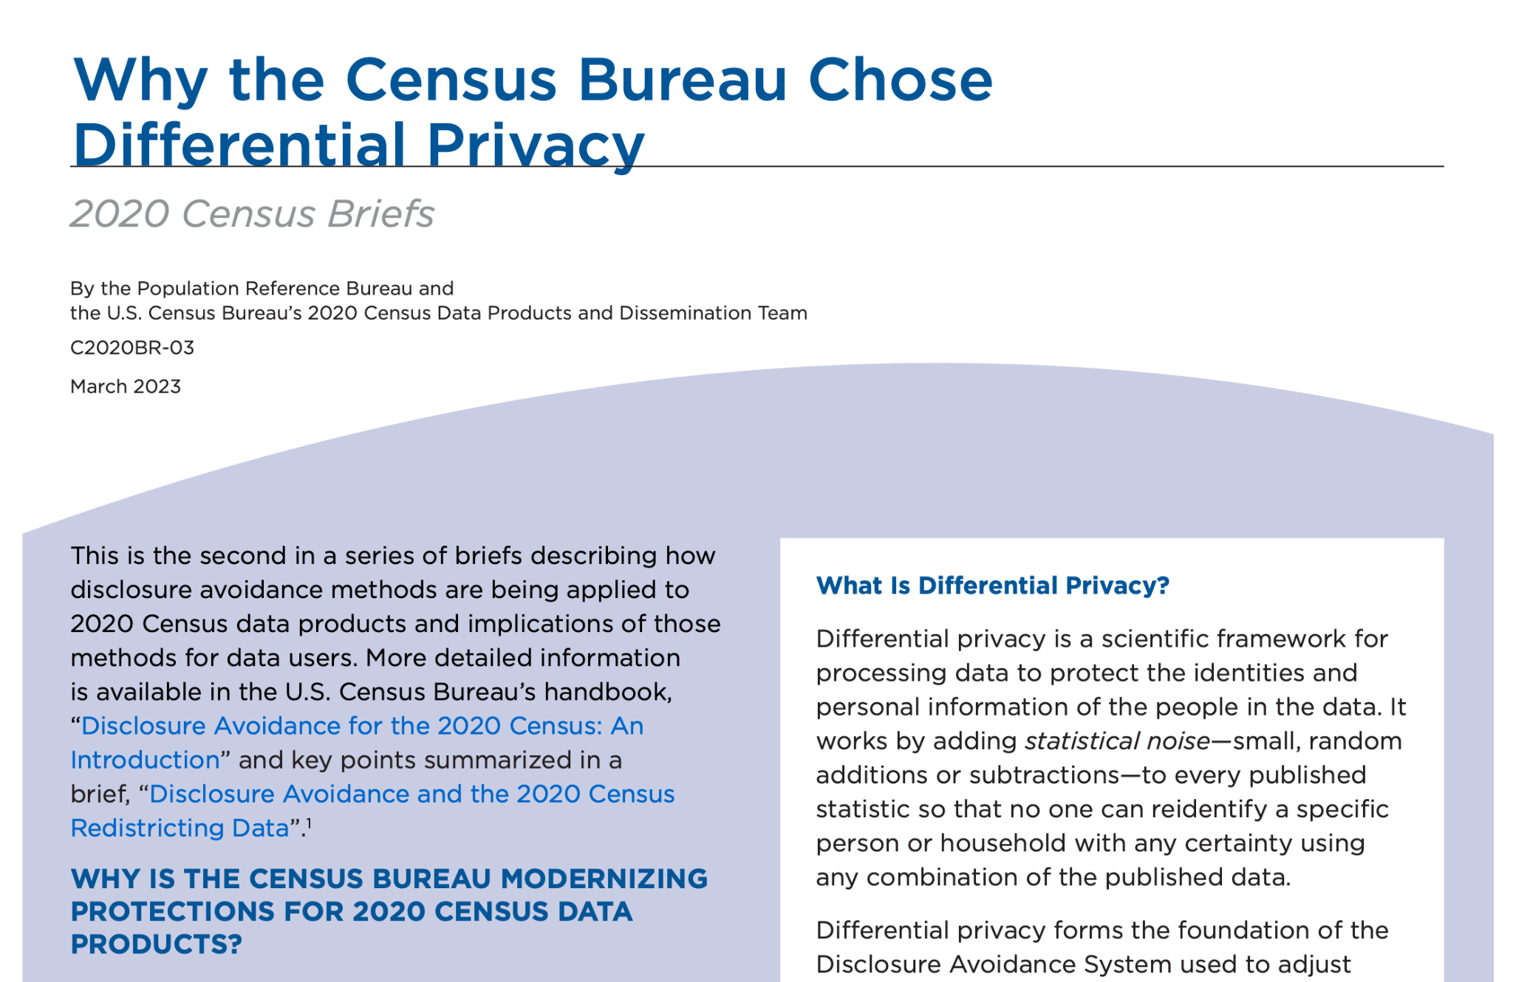
Differential Privacy Deployments
US Census
Google Chrome

Slide 121

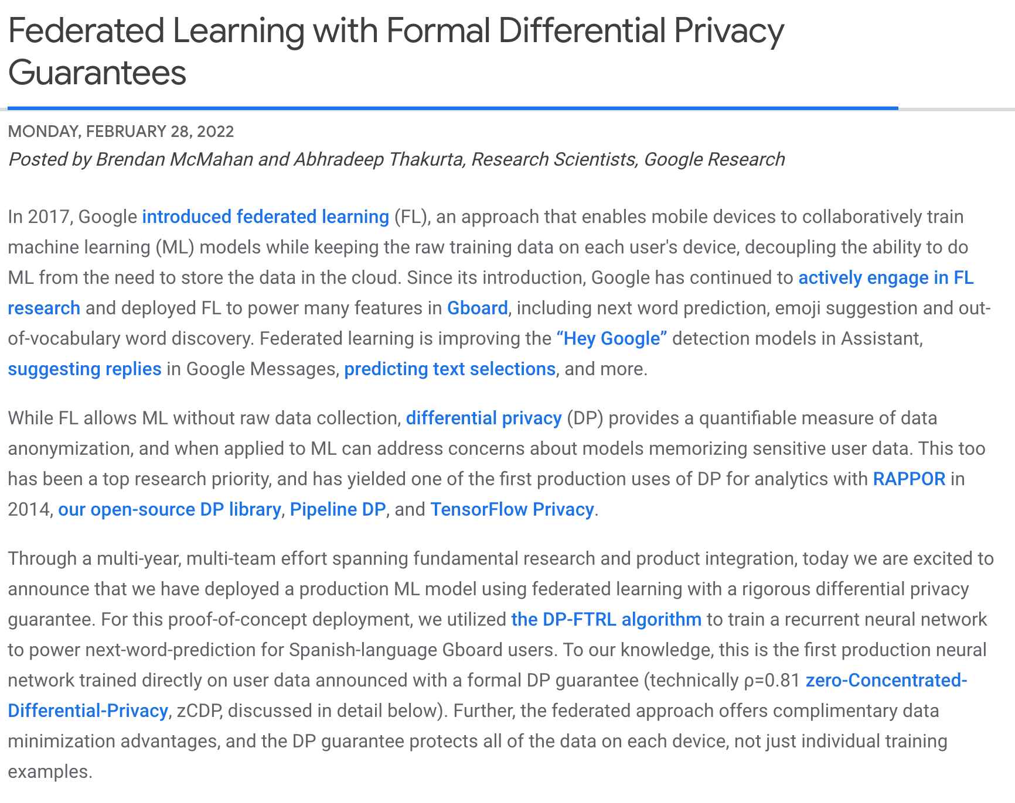
Differential Privacy Deployments (cont.)
Apple Photos
Google Gboard

Slide 122
Differential Privacy: Definition
Intuition:
“Adding or removing a single user should not change the output distribution too much”
(ε, δ)-Differential Privacy [Dwork et al.’06] For every neighboring datasets X, X’ and every set of outputs S, Pr[M(X) ∈ S] ≤ e^{ε}・Pr[M(X’) ∈ S] + δ
Pure-DP
Smaller ε, δ
ε-DP ☰ (ε, 0)-DP
⇔
More privacy
Approx-DP δ > 0
ε = small constant
δ = negligible in # of users

Slide 123
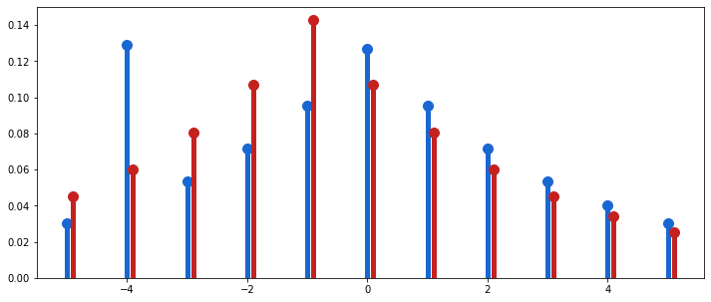
Privacy Loss (Discrete)
Privacy Loss
For M, X, X’, the privacy loss at output o is
L_{M,X,X’}(o) = ln(Pr[M(X) = o] / Pr[M(X’) = o])
If-and-only-if condition
Theorem (Pure-DP Condition)
M is ε-DP iff, for all X≍X’, o ∈ Range(M), L_{M,X,X’}(o) ≤ ε
Probability Mass
Input X
Input X’
Ratio > exp(0.5)
Not 0.5-DP!

Slide 124
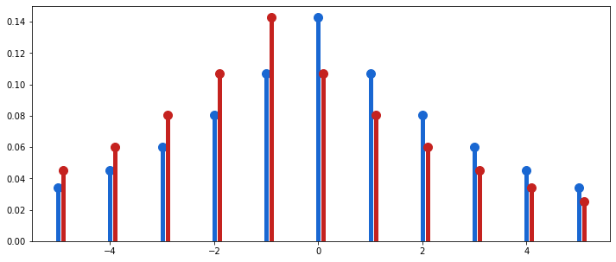

Privacy Loss (Discrete)
Privacy Loss
For M, X, X’, the privacy loss at output o is
L_{M,X,X’}(o) = ln(Pr[M(X) = o] / Pr[M(X’) = o])
If-and-only-if condition
Theorem (Pure-DP Condition)
M is ε-DP iff, for all X≍X’, o ∈ Range(M), L_{M,X,X’}(o) ≤ ε
Probability Mass
Input X
Input X’
Ratio ≤ exp(0.5)
0.5-DP!

Slide 125
Privacy Loss (Discrete)
Privacy Loss
For M, X, X’, the privacy loss at output o is
L_{M,X,X’}(o) = ln(Pr[M(X) = o] / Pr[M(X’) = o])
If-and-only-if condition
Theorem (Pure-DP Condition)
M is ε-DP iff, for all X≍X’, o ∈ Range(M), L_{M,X,X’}(o) ≤ ε
Proof (⇒)
Suppose that M is ε-DP.
Consider any X≍X’, o ∈ Range(M).
Pr[M(X)=o] = Pr[M(X)∈{o}]
≤ e^{ε}・Pr[M(X’) ∈ {o}]
= e^{ε}・Pr[M(X’) = o]
L_{M,X,X’}(o) ≤ ε
QED

Slide 126
Privacy Loss (Discrete)
Privacy Loss
For M, X, X’, the privacy loss at output o is
L_{M,X,X’}(o) = ln(Pr[M(X) = o] / Pr[M(X’) = o])
If-and-only-if condition
Theorem (Pure-DP Condition)
M is ε-DP iff, for all X≍X’, o ∈ Range(M), L_{M,X,X’}(o) ≤ ε
Proof (⇐)
Suppose that for all X≍X’, o ∈ Range(M), L_{M,X,X’}(o) ≤ ε.
Consider any S ⊆ Range(M).
Pr[M(X) ∈ S] = ∑_{o∈S} Pr[M(X) = o]
≤ ∑_{o∈S} e^{ε}・Pr[M(X’) = o]
= e^{ε}・Pr[M(X’) ∈ S]
QED

Slide 127
Basic Mechanism:
Noise Addition

Slide 128
Noise Addition Mechanism
X = (x₁, ..., x_{n})
Analyzer
Estimate of g(X)

Slide 129
Noise Addition Mechanism
X = (x₁, ..., x_{n})
Analyzer
g(X) + Random Noise
Intuition:
“Noise should be large enough to hide a user’s contribution”
What noise distribution should we use?
Depends on Range(g)
Depends on how “sensitive” g is

Slide 130
Discrete Laplace Mechanism
X = (x₁, ..., x_{n})
Analyzer
g(X) + Random Noise
Examples: COUNT Query
Assumption: Range(g) ⊆ 𝐙
g = COUNT(*) WHERE income > 40k
(i.e. g is integer-valued)
name | zipcode | age | income
Dale | 10520 | 40 | 150k
Bob | 10520 | 35 | 50k
Conor | 10500 | 30 | 30k
Sensitivity
Δ(g) = max_{X≍X’} |g(X) - g(X’)|
x₁
g(X) = 2
x₂
Larger sensitivity ⇒ More Noise Required
x₃

Slide 131
Discrete Laplace Mechanism
X = (x₁, ..., x_{n})
Analyzer
g(X) + Random Noise
Examples: COUNT Query
Assumption: Range(g) ⊆ 𝐙
g = COUNT(*) WHERE income > 40k
(i.e. g is integer-valued)
name | zipcode | age | income
Dale | 10520 | 40 | 150k
Bob | 10520 | 35 | 50k
Conor | 10500 | 30 | 60k
Sensitivity
Δ(g) = max_{X≍X’} |g(X) - g(X’)|
x₁
g(X) = 3
x₂
Larger sensitivity ⇒ More Noise Required
x₃
Δ(g) = 1

Slide 132
Discrete Laplace Mechanism
X = (x₁, ..., x_{n})
Analyzer
g(X) + Random Noise
Examples: SUM Query
Assumption: Range(g) ⊆ 𝐙
g = SUM(income)
(i.e. g is integer-valued)
name | zipcode | age | income
Dale | 10520 | 40 | 150k
Bob | 10520 | 35 | 50k
Conor | 10500 | 30 | 60k
Sensitivity
Δ(g) = max_{X≍X’} |g(X) - g(X’)|
x₁
g(X) = 260k
x₂
Larger sensitivity ⇒ More Noise Required
x₃

Slide 133
Discrete Laplace Mechanism
X = (x₁, ..., x_{n})
Analyzer
g(X) + Random Noise
Examples: SUM Query
Assumption: Range(g) ⊆ 𝐙
g = SUM(income)
(i.e. g is integer-valued)
name | zipcode | age | income
Dale | 10520 | 40 | 150k
Bob | 10520 | 35 | 50k
Conor | 10500 | 30 | 190k
Sensitivity
Δ(g) = max_{X≍X’} |g(X) - g(X’)|
x₁
g(X) = 390k
x₂
Larger sensitivity ⇒ More Noise Required
x₃
Assume income ≤ c
Δ(g) ≤ c

Slide 134
Discrete Laplace Mechanism
X = (x₁, ..., x_{n})
Analyzer
g(X) + Random Noise
Examples: AVERAGE Query
Assumption: Range(g) ⊆ 𝐙
g = AVG(income)
(i.e. g is integer-valued)
name | zipcode | age | income
Dale | 10520 | 40 | 150k
Bob | 10520 | 35 | 50k
Conor | 10500 | 30 | 190k
Sensitivity
Δ(g) = max_{X≍X’} |g(X) - g(X’)|
x₁
g(X) = 130k
x₂
Larger sensitivity ⇒ More Noise Required
x₃
Assume income ≤ c
Δ(g) ≤ c/n

Slide 135
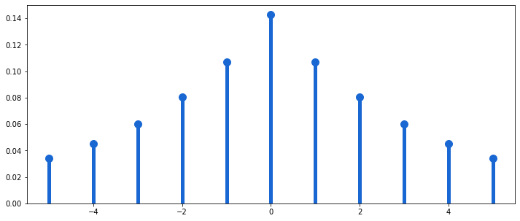
Discrete Laplace Mechanism
X = (x₁, ..., x_{n})
Analyzer
g(X) + Random Noise
Discrete Laplace Distribution
For every integer i,
Assumption: Range(g) ⊆ 𝐙
Pr[i = DLap(b)] ∝ e^{-|i|/b}
(i.e. g is integer-valued)
Probability Mass
Sensitivity
Δ(g) = max_{X≍X’} |g(X) - g(X’)|
Larger sensitivity ⇒ More Noise Required
Value

Slide 136
Discrete Laplace Mechanism
X = (x₁, ..., x_{n})
Analyzer
g(X) + DLap(Δ(g)/ε)
Discrete Laplace Distribution
For every integer i,
Assumption: Range(g) ⊆ 𝐙
Pr[i = DLap(b)] ∝ e^{-|i|/b}
(i.e. g is integer-valued)
Probability Mass
Sensitivity
Δ(g) = max_{X≍X’} |g(X) - g(X’)|
Larger sensitivity ⇒ More Noise Required
Value

Slide 137
Discrete Laplace Mechanism
X = (x₁, ..., x_{n})
Analyzer
g(X) + DLap(Δ(g)/ε)
Example:
Δ(g) = 1, ε = ln(4/3), g(X) = 3
Discrete Laplace Distribution
For every integer i,
Pr[i = DLap(b)] ∝ e^{-|i|/b}
Output: 3 + DLap(1/ln(4/3))
Probability Mass
Value

Slide 138
Discrete Laplace Mechanism
X = (x₁, ..., x_{n})
Analyzer
g(X) + DLap(Δ(g)/ε)
Example:
Δ(g) = 1, ε = ln(4/3), g(X) = 3
Discrete Laplace Distribution
For every integer i,
Pr[i = DLap(b)] ∝ e^{-|i|/b}
Output: 3 + DLap(1/ln(4/3))
Probability Mass
...
2 w.p. 3/28 = 0.1071...
output =
3 w.p. 1/7 = 0.1428...
4 w.p. 3/28 = 0.1071...
...
-1
1
g(X)=3
5
7
Value

Slide 139
Discrete Laplace Mechanism: Privacy
X = (x₁, ..., x_{n})
Analyzer
g(X) + DLap(Δ(g)/ε)
Theorem Assuming Range(g) ⊆𝐙, Discrete Laplace Mechanism is ε-DP.

Slide 140
Privacy Loss (Discrete)
Privacy Loss
For M, X, X’, the privacy loss at output o is
L_{M,X,X’}(o) = ln(Pr[M(X) = o] / Pr[M(X’) = o])
If-and-only-if condition
Theorem (Pure-DP Condition)
M is ε-DP iff, for all X≍X’, o ∈ Range(M), L_{M,X,X’}(o) ≤ ε

Slide 141
Discrete Laplace Mechanism: Privacy
X = (x₁, ..., x_{n})
Analyzer
g(X) + DLap(Δ(g)/ε)
Theorem Assuming Range(g) ⊆𝐙, Discrete Laplace Mechanism is ε-DP.
Illustration for Δ(g) = 1:
Proof
Let b = Δ(g)/ε.
For all X≍X’, o ∈ Range(M),
Input X
L_{M,X,X’}(o)
= ln(Pr[M(X) = o] / Pr[M(X’) = o])
= ln(exp(-|o - g(X)| / b) / exp(-|o - g(X’)| / b))
= (|o - g(X’)| - |o - g(X)|) / b
≤ |g(X) - g(X’)| / b
≤ Δ(g) / b = ε
Input X’
(triangle ineq.)
g(X’)
g(X)
QED
Value

Slide 142
Discrete Laplace Mechanism: Utility
X = (x₁, ..., x_{n})
Analyzer
g(X) + DLap(Δ(g)/ε)
Theorem Discrete Laplace Mechanism has RMSE = O(Δ(g)/ε)
Utility Measures
Mean Square Error (MSE): 𝐄[(output - true)²]
Root Mean Square Error (RMSE): √MSE
Mean Absolute Error (MAE): 𝐄[|output - true|]
In this tutorial, will mostly compute RMSE since it is easier to deal with
MAE is always ≤ RMSE

Slide 143
Discrete Laplace Mechanism: Utility
X = (x₁, ..., x_{n})
Analyzer
g(X) + DLap(Δ(g)/ε)
Error does not scale with dataset size!
Theorem Discrete Laplace Mechanism has RMSE = O(Δ(g)/ε)
Utility Measures
Mean Square Error (MSE): 𝐄[(output - true)²]
Root Mean Square Error (RMSE): √MSE
Mean Absolute Error (MAE): 𝐄[|output - true|]
In this tutorial, will mostly compute RMSE since it is easier to deal with
MAE is always ≤ RMSE

Slide 144
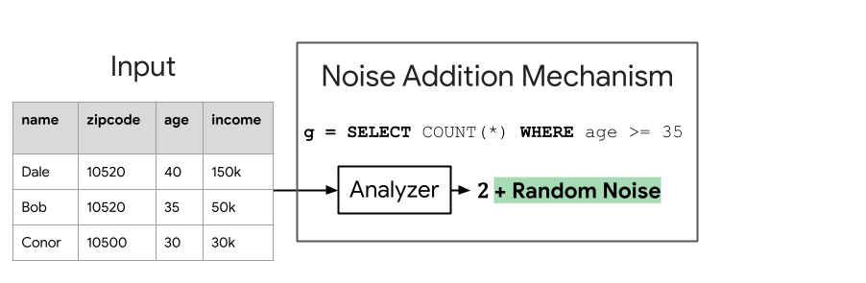
Noise Addition Mechanism
X = (x₁, ..., x_{n})
Analyzer
g(X) + Random Noise
Different noise ⇒ different privacy & utility guarantee
* The random noise has to be hidden from the adversary

Slide 145
Discrete Laplace Mechanism
X = (x₁, ..., x_{n})
Analyzer
g(X) + DLap(Δ(g)/ε)
Theorem Assuming Range(g) ⊆𝐙, Discrete Laplace Mechanism is ε-DP.
Discrete Laplace Distribution
For every integer i,
Assumption: Range(g) ⊆ 𝐙
Pr[i = DLap(b)] ∝ e^{-|i|/b}
(i.e. g is integer-valued)
Probability Mass
Sensitivity
Δ(g) = max_{X≍X’} |g(X) - g(X’)|
Larger sensitivity ⇒ More Noise Required
Value

Slide 146
Discrete Laplace: Multi-Dimension
X = (x₁, ..., x_{n})
Analyzer
g(X) + DLap(Δ(g)/ε)
Examples: Histogram
Assumption: Range(g) ⊆ 𝐙^{d}
(i.e. g is vector-valued with integer entries)
name | zipcode | age | income
Dale | 10520 | 40 | 150k
Bob | 10520 | 35 | 50k
...
Conor | 10500 | 30 | 30k
x₁
𝓵_{p}-Sensitivity
Δ_{p}(g) = max_{X≍X’} ||g(X) - g(X’)||_{p}
x₂
x_{n}
𝓵_{p}-Norm
||v||_{p} = (|v₁|^{p} + ... + |v_{d}|^{p})^{1/p}

Slide 147
Discrete Laplace: Multi-Dimension
X = (x₁, ..., x_{n})
Analyzer
g(X) + DLap(Δ(g)/ε)
Examples: Histogram
Assumption: Range(g) ⊆ 𝐙^{d}
Histogram of income
(i.e. g is vector-valued with integer entries)
# people
g(X) = (200, 50, 100, 55, 20)
𝓵_{p}-Sensitivity
Δ_{p}(g) = max_{X≍X’} ||g(X) - g(X’)||_{p}
0-50k
51-100k
101-150k
150-200k
201-250k
𝓵_{p}-Norm
||v||_{p} = (|v₁|^{p} + ... + |v_{d}|^{p})^{1/p}
income

Slide 148
Discrete Laplace: Multi-Dimension
X = (x₁, ..., x_{n})
Analyzer
g(X) + DLap(Δ(g)/ε)
Examples: Histogram
Assumption: Range(g) ⊆ 𝐙^{d}
Histogram of income
(i.e. g is vector-valued with integer entries)
# people
g(X) = (199, 50, 101, 55, 20)
𝓵_{p}-Sensitivity
Δ_{p}(g) = max_{X≍X’} ||g(X) - g(X’)||_{p}
0-50k
51-100k
101-150k
150-200k
201-250k
𝓵_{p}-Norm
||v||_{p} = (|v₁|^{p} + ... + |v_{d}|^{p})^{1/p}
income
Changing a row effects two buckets by ≤ 1
Δ₁(g) ≤ 2

Slide 149
Discrete Laplace: Multi-Dimension
X = (x₁, ..., x_{n})
Analyzer
g(X) + DLap(Δ₁(g)/ε)^{⛒d}
Use 𝓵₁-sensitivity
Each coordinate is independent
Examples: Histogram
Assumption: Range(g) ⊆ 𝐙^{d}
Histogram of income
(i.e. g is vector-valued with integer entries)
# people
g(X) = (199, 50, 101, 55, 20)
𝓵_{p}-Sensitivity
Δ_{p}(g) = max_{X≍X’} ||g(X) - g(X’)||_{p}
0-50k
51-100k
101-150k
150-200k
201-250k
𝓵_{p}-Norm
||v||_{p} = (|v₁|^{p} + ... + |v_{d}|^{p})^{1/p}
income
Changing a row effects two buckets by ≤ 1
Δ₁(g) ≤ 2

Slide 150
Discrete Laplace: Multi-Dimension
X = (x₁, ..., x_{n})
Analyzer
g(X) + DLap(Δ₁(g)/ε)^{⛒d}
Theorem Assuming Range(g) ⊆𝐙^{d}, Discrete Laplace Mechanism is ε-DP.
Proof
Let b = Δ₁(g)/ε.
For all X≍X’, o ∈ Range(M),
L_{M,X,X’}(o) = ln(Pr[M(X) = o] / Pr[M(X’) = o])
= ln(∏_{i∈[d]} exp(-|o_{i} - g(X)_{i}| / b) / exp(-|o_{i} - g(X’)_{i}| / b)
= ∑_{i∈[d]} (|o_{i} - g(X’)_{i}| - |o_{i} - g(X)_{i}|) / b
≤ ∑_{i∈[d]} |g(X)_{i} - g(X’)_{i}| / b
= ||g(X) - g(X’)||₁
≤ Δ₁(g) / b = ε
(triangle ineq.)
QED

Slide 151
Discrete Laplace Mechanism
X = (x₁, ..., x_{n})
Analyzer
g(X) + DLap(Δ(g)/ε)
Theorem Assuming Range(g) ⊆𝐙, Discrete Laplace Mechanism is ε-DP.
Discrete Laplace Distribution
For every integer i,
Assumption: Range(g) ⊆ 𝐙
Pr[i = DLap(b)] ∝ e^{-|i|/b}
(i.e. g is integer-valued)
Necessary!
If g(X) = 0.1, g(X’) = 0.2
Noise added is integer
Doesn’t change the fractional part
Adversary can tell exactly which dataset it comes from
Sensitivity
Δ(g) = max_{X≍X’} |g(X) - g(X’)|
Larger sensitivity ⇒ More Noise Required

Slide 152
Probability Review II

Slide 153
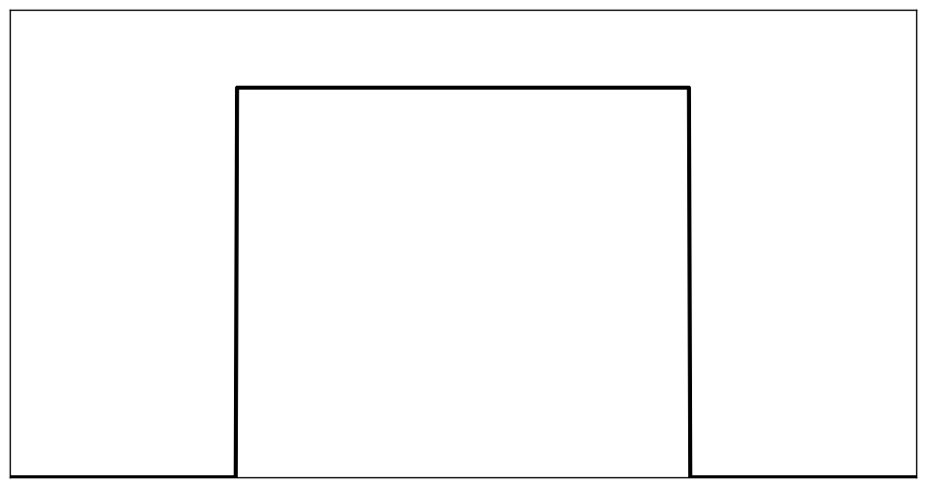
Probability Review II
supp(X) = [0,1]
Random Variable
Probability Density
X = random number in [0, 1]
1
1 if c is in [0, 1]
f_{X}(c)
0 otherwise
Outcome
Identity
Pr[a ≤ X ≤ b] = ∫_{a}^{b} f_{X}(c) dc
0
1
Notation f_{X}(c) = Probability Density at c

Slide 154
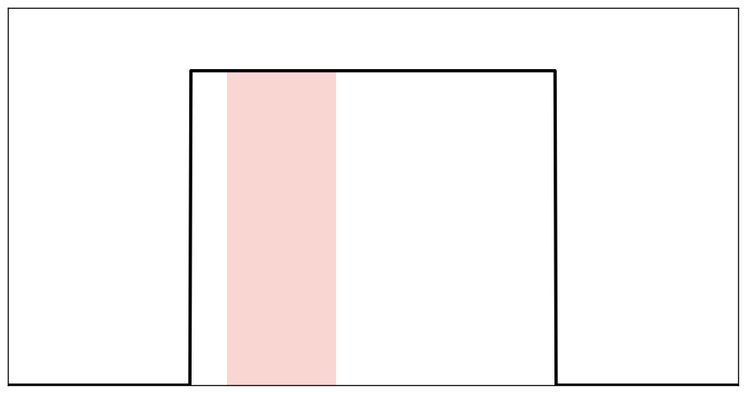
Probability Review II
supp(X) = [0,1]
Probability Density
a = 0.1, b = 0.3
Random Variable
X = random number in [0, 1]
1
1 if c is in [0, 1]
f_{X}(c)
0 otherwise
Outcome
Identity
Pr[a ≤ X ≤ b] = ∫_{a}^{b} f_{X}(c) dc
a
b
Notation f_{X}(c) = Probability Density at c
Identity For all “measurable” S, Pr[X∈S] = ∫_{S} f_{X}(c) dc

Slide 155
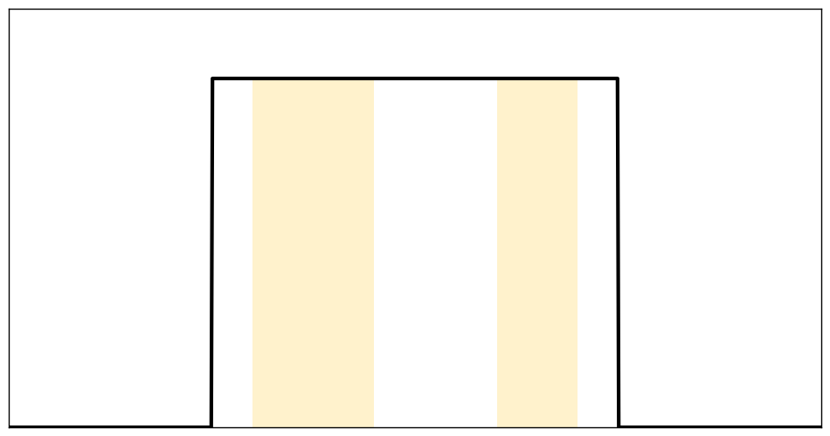
Probability Review II
supp(X) = [0,1]
Probability Density
S = [0.1, 0.3] Ս [0.7, 0.9]
Random Variable
X = random number in [0, 1]
1
1 if c is in [0, 1]
f_{X}(c)
0 otherwise
Outcome
Identity
Pr[a ≤ X ≤ b] = ∫_{a}^{b} f_{X}(c) dc
0.1
0.3
0.7
0.9
Notation f_{X}(c) = Probability Density at c
Identity For all “measurable” S, Pr[X∈S] = ∫_{S} f_{X}(c) dc

Slide 156
Privacy Loss
Discrete outputs
Continuous outputs
Privacy Loss
For M, X, X’, the privacy loss at output o is
L_{M,X,X’}(o) = ln(Pr[M(X) = o] / Pr[M(X’) = o])
Privacy Loss
For M, X, X’, the privacy loss at output o is
L_{M,X,X’}(o) = ln(f_{M(X)}(o) / f_{M(X’)}(o))

Slide 157
Privacy Loss
Discrete outputs
Continuous outputs
Privacy Loss
For M, X, X’, the privacy loss at output o is
L_{M,X,X’}(o) = ln(Pr[M(X) = o] / Pr[M(X’) = o])
Privacy Loss
For M, X, X’, the privacy loss at output o is
L_{M,X,X’}(o) = ln(f_{M(X)}(o) / f_{M(X’)}(o))
“Ration of Probability Masses”
“Ratio of Probability Densities”
Theorem (Pure-DP Condition)
M is ε-DP iff, for all X≍X’, o ∈ Range(M), L_{M,X,X’}(o) ≤ ε

Slide 158
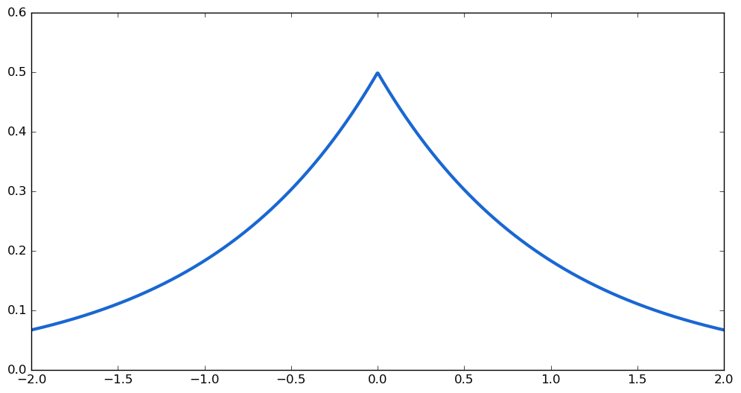
Laplace Mechanism
X = (x₁, ..., x_{n})
Analyzer
g(X) + Random Noise
Probability Density
Assumption: Range(g) ⊆ 𝐑
(i.e. g is real-valued)
Laplace Distribution
For every real number z,
f_{Lap(b)}(z) ∝ e^{-|z|/b}
Value

Slide 159
Laplace Mechanism
X = (x₁, ..., x_{n})
Analyzer
g(X) + Lap(Δ(g)/ε)
Theorem Assuming Range(g) ⊆𝐑, Laplace Mechanism is ε-DP.
Probability Density
Assumption: Range(g) ⊆ 𝐑
(i.e. g is real-valued)
Laplace Distribution
For every real number z,
f_{Lap(b)}(z) ∝ e^{-|z|/b}
Value

Slide 160
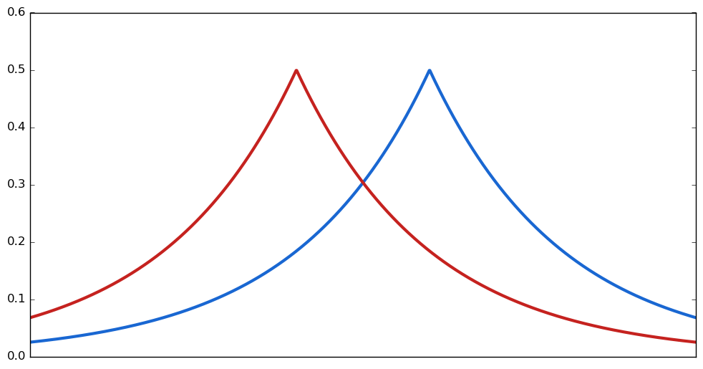
Laplace Mechanism
X = (x₁, ..., x_{n})
Analyzer
g(X) + Lap(Δ(g)/ε)
Theorem Assuming Range(g) ⊆𝐑, Laplace Mechanism is ε-DP.
Theorem RMSE = O(Δ(g)/ε)
Probability Density
Assumption: Range(g) ⊆ 𝐑
(i.e. g is real-valued)
Input X
Input X’
Laplace Distribution
For every real number z,
f_{Lap(b)}(z) ∝ e^{-|z|/b}
g(X’)
g(X)
Value

Slide 161
Laplace Mechanism: Multi-Dimension
X = (x₁, ..., x_{n})
Analyzer
g(X) + Lap(Δ₁(g)/ε)^{⛒d}
Use 𝓵₁-sensitivity
Each coordinate is independent
Theorem Assuming Range(g) ⊆𝐑^{d}, Laplace Mechanism is ε-DP.
Assumption: Range(g) ⊆ 𝐑^{d}
(i.e. g is vector-valued with real entries)
Laplace Distribution
For every real number z,
f_{Lap(b)}(z) ∝ e^{-|z|/b}

Slide 162
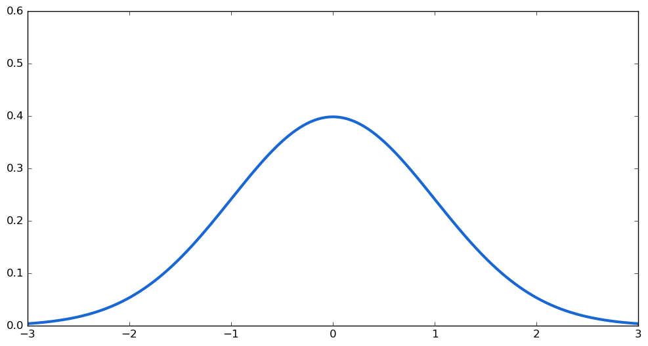
Gaussian Mechanism
X = (x₁, ..., x_{n})
Analyzer
g(X) + 𝒩(0, σ²)
Probability Density
Assumption: Range(g) ⊆ 𝐑
(i.e. g is real-valued)
Gaussian Distribution
For every real number z,
₂
PDF_{𝒩(0, σ )}(z) ∝ e^{-(z/σ)}
₂
Value

Slide 163
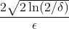
Gaussian Mechanism
σ = ⋅ Δ(g)
X = (x₁, ..., x_{n})
Analyzer
g(X) + 𝒩(0, σ²)
Theorem Assuming Range(f) ⊆𝐑 and ε ≤ 1, Gaussian Mechanism is (ε, δ)-DP.
Probability Density
Assumption: Range(g) ⊆ 𝐑
(i.e. g is real-valued)
Gaussian Distribution
For every real number z,
₂
PDF_{𝒩(0, σ )}(z) ∝ e^{-(z/σ)}
₂
Value

Slide 164
Gaussian Mechanism
σ = ⋅ Δ(g)
X = (x₁, ..., x_{n})
Analyzer
g(X) + 𝒩(0, σ²)
Theorem Assuming Range(f) ⊆𝐑 and ε ≤ 1, Gaussian Mechanism is (ε, δ)-DP.
Assumption: Range(g) ⊆ 𝐑
(i.e. g is real-valued)
Proof is a bit complicated... Will skip for now.
Gaussian Distribution
For every real number z,
₂
PDF_{𝒩(0, σ )}(z) ∝ e^{-(z/σ)}
₂

Slide 165
Gaussian Mechanism
σ = ⋅ Δ₂(g)
X = (x₁, ..., x_{n})
Analyzer
g(X) + 𝒩(0, σ²)^{⛒d}
Use 𝓵₂-sensitivity
Each coordinate is independent
Theorem Assuming Range(f) ⊆𝐑^{d} and ε ≤ 1, Gaussian Mechanism is (ε, δ)-DP.
Assumption: Range(g) ⊆ 𝐑^{d}
(i.e. g is vector-valued with real entries)
Proof is a bit complicated... Will skip for now.
Gaussian Distribution
For every real number z,
₂
PDF_{𝒩(0, σ )}(z) ∝ e^{-(z/σ)}
₂

Slide 166
Gaussian Mechanism
σ = ⋅ Δ₂(g)
X = (x₁, ..., x_{n})
Analyzer
g(X) + 𝒩(0, σ²)^{⛒d}
Use 𝓵₂-sensitivity
Each coordinate is independent
Theorem Assuming Range(f) ⊆𝐑^{d} and ε ≤ 1, Gaussian Mechanism is (ε, δ)-DP.
Examples: Vector summation
Assumption: Range(g) ⊆ 𝐑^{d}
(0.2, -1, 1)
(i.e. g is vector-valued with real entries)
User 1
...
g(X) = (50.1, 2.3, 14.7)
Gaussian Distribution
For every real number z,
(0, 2, -0.1)
₂
User n
PDF_{𝒩(0, σ )}(z) ∝ e^{-(z/σ)}
₂
Assumption: Each vector has 𝓵₂-norm ≤ C
Δ₂(g) ≤ 2C

Slide 167
Privacy Loss Distribution
Discrete outputs
Continuous outputs
Privacy Loss
For M, X, X’, the privacy loss at output o is
L_{M,X,X’}(o) = ln(Pr[M(X) = o] / Pr[M(X’) = o])
Privacy Loss
For M, X, X’, the privacy loss at output o is
L_{M,X,X’}(o) = ln(f_{M(X)}(o) / f_{M(X’)}(o))
Privacy Loss Distribution
PLD_{M,X,X’} is the distribution of L_{M,X,X’}(o) where o~M(X)
Inverse doesn’t hold*
If-and-only-if condition
Approximate-DP Condition
M is (ε, δ)-DP if, for all X≍X’,
Pr[y > ε] ≤ δ where y ~ PLD_{M,X,X’}
Pure-DP Condition
M is ε-DP iff, for all X≍X’, o ∈ Range(M),
L_{M,X,X’}(o) ≤ ε
* there is an iff version but more complicated

Slide 168
Gaussian Mechanism
σ = ⋅ Δ(g)
X = (x₁, ..., x_{n})
Analyzer
g(X) + 𝒩(0, σ²)
Theorem Assuming Range(f) ⊆𝐑 and ε ≤ 1, Gaussian Mechanism is (ε, δ)-DP.
Proof Ideas
PLD_{M, X, X’} is another Gaussian dist.
Pr[y > ε] where y ~ PLD_{M,X,X’} is just “tail bound” of Gaussian distribution
Using known inequalities this quantity can be shown to be at most δ
Assumption: Range(g) ⊆ 𝐑
(i.e. g is real-valued)
Gaussian Distribution
For every real number z,
₂
PDF_{𝒩(0, σ )}(z) ∝ e^{-(z/σ)}
₂

Slide 169
Gaussian Mechanism
σ = ⋅ Δ₂(g)
Use 𝓵₂-sensitivity
Each coordinate is independent
X = (x₁, ..., x_{n})
Analyzer
g(X) + 𝒩(0, σ²)^{⛒d}
Theorem Assuming Range(f) ⊆𝐑^{d} and ε ≤ 1, Gaussian Mechanism is (ε, δ)-DP.
Assumption: Range(g) ⊆ 𝐑^{d}
Proof Ideas
PLD_{M, X, X’} is another Gaussian dist.
Pr[y > ε] where y ~ PLD_{M,X,X’} is just “tail bound” of Gaussian distribution
Using known inequalities this quantity can be shown to be at most δ
(i.e. g is vector-valued with real entries)
Gaussian Distribution
For every real number z,
₂
PDF_{𝒩(0, σ )}(z) ∝ e^{-(z/σ)}
₂

Slide 170
Protection Against Privacy Attacks

Slide 171
Review: Privacy Attack Measure
Dataset X’
Add/Remove Neighbors
Dataset X
User 1
User 1
Doesn’t contain user A
...
User n
...
User n
User A
Algorithm M
Algorithm M
Output
Output
Privacy violation score
Privacy violation score
Compare
s_{out}
s_{in}

Slide 172
Review: Privacy Attack Measure
Theorem Suppose that privacy violation score is in [0, 1] and the algorithm is (ε, δ)-Add/Remove DP. Then, we have
E[s_{in}] ≤ e^{ε} ⋅ E[s_{out}] + δ
Proof
Let s denote the scoring function.
E[s_{in}] = E[s(M(X))]
= ∫₀∞ Pr[s(M(X)) > c] d c
= ∫₀¹ Pr[s(M(X)) > c] d c
≤ ∫₀¹ (e^{ε} ⋅ Pr[s(M(X’)) > c] + δ) d c
= e^{ε} ⋅ E[s(M(X’))] + δ = e^{ε} ⋅ E[s_{out}] + δ
QED

Slide 173
Properties of DP

Slide 174
Post-Processing
“Result of DP algorithm can be used in arbitrary manner and it remains DP.”
Theorem If M is (ε, δ)-DP and h is any function, then h(M(X)) remains (ε, δ)-DP.
Dataset
Build ML model
User 1
(ε, δ)-DP Algo
Output
Business decision
...
User n
...
Can we use the output safely in downstream applications?

Slide 175
Composition
SELECT COUNT(*) WHERE age >= 40
SELECT COUNT(*) WHERE income >= 30k
name | zipcode | age | income
Dale | 10520 | 40 | 150k
Bob | 10520 | 35 | 50k
Conor | 10500 | 30 | 30k
Alice | 10500 | 41 | 20k
...
2 + Noise
Algorithm
3 + Noise
...

Slide 176
Composition
SELECT COUNT(*) WHERE age >= 40
2 + Noise
Algorithm 1
name | zipcode | age | income
Dale | 10520 | 40 | 150k
Bob | 10520 | 35 | 50k
Conor | 10500 | 30 | 30k
Alice | 10500 | 41 | 20k
(ε₁, δ₁)-DP
SELECT COUNT(*) WHERE income >= 30k
3 + Noise
Algorithm 2
(ε₂, δ₂)-DP
...
...
“Running DP algorithms multiple times remain DP, but with worse parameters”

Slide 177
Composition
(ε₁, δ₁)-DP Algo
Output 1
Dataset
User 1
(ε₂, δ₂)-DP Algo
Output 2
...
User n
...
(ε_{k}, δ_{k})-DP Algo
Output k
“Running DP algorithms multiple times remain DP, but with worse parameters”

Slide 178
Basic Composition
(ε₁, δ₁)-DP Algo
Output 1
Dataset
User 1
(ε₂, δ₂)-DP Algo
Output 2
...
User n
...
(ε_{k}, δ_{k})-DP Algo
Output k
Basic Composition Theorem [Dwork et al.]
All the outputs combined remain (ε₁+ε₂+...+ε_{k}, δ₁+δ₂+...+δ_{k})-DP

Slide 179
Basic Composition
(ε₁, δ₁)-DP Algo
Output 1
“Adaptive” setting: previous outputs are used in subsequent algorithms
Dataset
User 1
(ε₂, δ₂)-DP Algo
Output 2
...
User n
...
(ε_{k}, δ_{k})-DP Algo
Output k
Basic Composition Theorem [Dwork et al.]
All the outputs combined remain (ε₁+ε₂+...+ε_{k}, δ₁+δ₂+...+δ_{k})-DP
Works even for “adaptive” setting

Slide 180
Advanced Composition
(ε, δ)-DP Algo
Output 1
Dataset
User 1
(ε, δ)-DP Algo
Output 2
...
User n
...
(ε, δ)-DP Algo
Output k
Advanced Composition Theorem [Dwork et al.]
All the outputs combined is (ε’, kδ + δ’)-DP where
ε’ =
For small ε and large k, ε’ is only ≈ ε√k
Better than ε’=εk from Basic composition

Slide 181
Parallel Composition
Disjoint partition
Dataset
User 1
(ε, δ)-DP Algo
Output 1
...
Dataset
User n
User 1
...
...
...
User n
Dataset
User 3
(ε, δ)-DP Algo
Output k
...
User n-1
Parallel Composition Theorem [McSherry]
All the outputs combined remain (ε, δ)-DP

Slide 182
Amplification by Subsampling
“Subsampling makes the algorithm more private.”
Sample B-out-of-n users randomly
Dataset
Dataset
Substitution DP
User 1
User 3
(ε, δ)-DP Algo
Output
...
...
User n
User n - 5
Substitution DP
Amplification-by-subsampling Theorem
The output combined is (ε’, δ’)-DP where
ε’ = ln(1 + p(e^{ε} - 1)), δ’ = pδ
with p = B / n.

Slide 183
Amplification by Subsampling
“Subsampling makes the algorithm more private.”
Sample each user with probability p
Dataset
Dataset
Add/Remove DP
User 1
User 3
(ε, δ)-DP Algo
Output
...
...
User n
User n - 5
Add/Remove DP
Amplification-by-subsampling Theorem
The output combined is (ε’, δ’)-DP where
ε’ = ln(1 + p(e^{ε} - 1)), δ’ = pδ.

Slide 184
Group Privacy
Example:
Email | zipcode | Purchase value
dale123@gmail.com | 10520 | 500
dale1993@gmail.com | 10520 | 25
alice@gmail.com | 10500 | 15
bob@gmail.com | 10500 | 40
ε-DP Algo
Output

Slide 185
Group Privacy
k-Neighboring
X, X’ are k-neighboring, denoted by ≍_{k} iff there exist a sequence X = X₀ ≍ X₁ ≍ ... ≍ X_{t} = X’ where t ≤ k.
Theorem If M is (ε, δ)-DP under neighboring notion ≍, then M(X) is (ε’, δ’)-DP for neighboring notion ≍_{k}, where ε’ = kε and δ’ = (e^{kε} - 1) / (e^{ε} - 1) ⋅ δ.
Example:
Email | zipcode | Purchase value
dale123@gmail.com | 10520 | 500
dale1993@gmail.com | 10520 | 25
alice@gmail.com | 10500 | 15
bob@gmail.com | 10500 | 40
Is this still DP?
Yes, it is 2ε-DP
Same individual
ε-DP Algo
Output

Slide 186
Differential Privacy: Neighboring Notions
Add/remove-DP
Substitution-DP
X is X’ with an individual’s data added / removed
X is X’ with an individual’s data changed
X ≍^{r} X’
X ≍^{s} X’
Protect against Membership Inference
Cannot reveal the raw size of the dataset
Sometimes make it harder to design & analyze algorithms for
Does not Protect against Membership Inference
Can reveal the raw size of the dataset
In this tutorial, if not stated, assume substitution-DP

Slide 187
Group Privacy
k-Neighboring
X, X’ are k-neighboring, denoted by ≍_{k} iff there exist a sequence X = X₀ ≍ X₁ ≍ ... ≍ X_{t} = X’ where t ≤ k.
Theorem If M is (ε, δ)-DP under neighboring notion ≍, then M(X) is (ε’, δ’)-DP for neighboring notion ≍_{k}, where ε’ = kε and δ’ = (e^{kε} - 1) / (e^{ε} - 1) ⋅ δ.
Example:
X is X’ with an individual’s data added / removed
Observation
If X ≍^{s} X’, then X ≍^{r}₂ X’
Add/remove
X ≍^{r} X’
X is X’ with an individual’s data changed
Substitution
X ≍^{s} X’
“Every substitution neighbor is a 2-add/remove neighbor”

Slide 188
Group Privacy
k-Neighboring
X, X’ are k-neighboring, denoted by ≍_{k} iff there exist a sequence X = X₀ ≍ X₁ ≍ ... ≍ X_{t} = X’ where t ≤ k.
Theorem If M is (ε, δ)-DP under neighboring notion ≍, then M(X) is (ε’, δ’)-DP for neighboring notion ≍_{k}, where ε’ = kε and δ’ = (e^{kε} - 1) / (e^{ε} - 1) ⋅ δ.
Example:
Observation
If X ≍^{s} X’, then X ≍^{r}₂ X’
Lemma
If M is ε-add/remove-DP, then it is 2ε-substitution-DP
“Every substitution neighbor is a 2-add/remove neighbor”

Slide 189
Group Privacy: Proof
k-Neighboring
X, X’ are k-neighboring, denoted by ≍_{k} iff there exist a sequence X = X₀ ≍ X₁ ≍ ... ≍ X_{t} = X’ where t ≤ k.
Theorem If M is (ε, δ)-DP under neighboring notion ≍, then M(X) is (ε’, δ’)-DP for neighboring notion ≍_{k}, where ε’ = kε and δ’ = (e^{kε} - 1) / (e^{ε} - 1) ⋅ δ.
Proof
Consider any X≍_{k}X’, S ⊆ Range(M). By defn, there is X = X₀ ≍ X₁ ≍ ... ≍ X_{t} = X’ where t ≤ k
Pr[M(X) ∈ S] ≤ e^{ε} Pr[M(X₁) ∈ S] + δ
≤ e^{ε} (e^{ε} Pr[M(X₂) ∈ S] + δ) + δ
...
≤ e^{tε} Pr[M(X’) ∈ S] + (e^{tε} - 1) / (e^{ε} - 1) ⋅ δ
≤ e^{kε} Pr[M(X’) ∈ S] + (e^{kε} - 1) / (e^{ε} - 1) ⋅ δ
QED

Slide 190
Machine Learning
with Differential Privacy

Slide 191
ML Model
Sample x
Model with parameter w
Prediction f_{w}(x)
Example: neural network
w₁
w₂
w₉
x₁
...
w₁₀
x₂
w₁₁
f_{w}(x)
w₁₂
x₃

Slide 192
Training ML Model
Ensure that the model is privacy-safe to be used in downstream tasks
Training Dataset
(ε, δ)-DP
(x₁, y₁)
Algorithm
Model
...
(x_{n}, y_{n})
Assumption: Each individual has a single labelled example
X is X’ with single training example changed
Substitution-DP
X ≍^{s} X’

Slide 193
DP-SGD Algorithm

Slide 194
Gradient Descent
Training data X
Gradient
⛛_{w} 𝓛(X) = [d 𝓛(X) / d w₁, ..., d 𝓛(X) / d w_{d}]
Labeled Samples
(x₁, y₁), (x₂, y₂), ..., (x_{n}, y_{n})
⛛_{w} 𝓛(X) = Σ_{i∈[n]} ⛛_{w} 𝓵(f_{w}(x_{i}), y_{i}) / n
Loss function: 𝓵(ŷ, y) ∈ 𝐑
η_{t}: learning rate
Empirical loss
𝓛_{w}(X) := Σ_{i∈[n]} 𝓵(f_{w}(x_{i}), y_{i}) / n
Gradient Descent (GD)
w₀←initial parameter
For t = 1,...,T:
w_{t} ← w_{t-1} - η_{t} ⛛_{w} 𝓛(X)
Return w_{T}
Training Objective
Find w that minimizes 𝓛_{w}(X)

Slide 195
Gradient Descent
Gradient Descent (GD)
w₀←initial parameter
For t = 1,...,T:
w_{t} ← w_{t-1} - η_{t} ⛛_{w} 𝓛(X)
Return w_{T}

Slide 196
Gradient Descent
Gradient Descent (GD)
w₀←initial parameter
For t = 1,...,T:
w_{t} ← w_{t-1} - η_{t} (Σ_{i∈[n]} ⛛_{w} 𝓵(f_{w}(x_{i}), y_{i})) / n
Return w_{T}

Slide 197
Gaussian Mechanism
σ = ⋅ Δ₂(g)
Analyzer
Use 𝓵₂-sensitivity
Each coordinate is independent
X = (x₁, ..., x_{n})
g(X) + 𝒩(0, σ²)^{⛒d}
Theorem Assuming Range(f) ⊆𝐑^{d} and ε ≤ 1, Gaussian Mechanism is (ε, δ)-DP.
Examples: Vector summation
Assumption: Range(g) ⊆ 𝐑^{d}
(0.2, -1, 1)
(i.e. g is vector-valued with real entries)
User 1
...
g(X) = (50.1, 2.3, 14.7)
Gaussian Distribution
For every real number z,
(0, 2, -0.1)
₂
User n
PDF_{𝒩(0, σ )}(z) ∝ e^{-(z/σ)}
₂
Assumption: Each vector has 𝓵₂-norm ≤ C
Δ₂(g) ≤ 2C

Slide 198
Additional parameters
σ: noise standard deviation
Gradient Descent
Add Gaussian noise to average gradients!
Gradient Descent (GD)
w₀←initial parameter
For t = 1,...,T
w_{t} ← w_{t-1} - η_{t} (N(0, σ²⋅I) + Σ_{i∈[n]} ⛛_{w} 𝓵(f_{w}(x_{i}), y_{i})) / n
Return w_{T}
Not differentially private: each ⛛_{w} 𝓵(f_{w}(x_{i}), y_{i})) can be arbitrarily large!

Slide 199
Additional parameters
σ: noise standard deviation
C: clipping norm
Clipping Trick
DP-GD
w₀←initial parameter
For t = 1,...,T:
For i = 1, ..., n:
v_{i} = ⛛_{w} 𝓵(f_{w}(x_{i}), y_{i})
v_{i} = v_{i}⋅min(1, C / ||v_{i}||₂)
w_{t} ← w_{t-1} - η_{t} (N(0, σ²⋅I) + Σ_{i∈[n]} v_{i}) / n
Return w_{T}
Enforce: gradient norm bound at most C
Not differentially private: each ⛛_{w} 𝓵(f_{w}(x_{i}), y_{i})) can be arbitrarily large!
“If ⛛_{w} 𝓵(f_{w}(x_{i}), y_{i})) is too large, rescale it to be smaller”

Slide 200
DP-GD: Privacy Analysis
Gaussian mechanism:
𝓵₂-sensitivity ≤ 2C
Noise std σ
(ε_{g}, δ_{g})-DP
u₁ = N(0, σ²⋅I) + Σ_{i∈[n]} v_{i})
w₁ = w₀ - η₁⋅u₁/n
w₁
Dataset
T-fold basic / advanced composition
User 1
...
u₂ = N(0, σ²⋅I) + Σ_{i∈[n]} v_{i})
w₂ = w₁ - η₂⋅u₂/n
w₂
User n
Entire Algo is (ε, δ)-DP
...
w_{T} = ...
w_{T}
Actually can release all of w₁, ... ,w_{T}!

Slide 201
DP-GD: Privacy Analysis
Each iteration
Gaussian mechanism:
𝓵₂-sensitivity ≤ 2C
Noise std σ
⇒ (ε_{g}, δ_{g})-DP
DP-GD
w₀←initial parameter
For t = 1,...,T:
For i = 1, ..., n:
v_{i} = ⛛_{w} 𝓵(f_{w}(x_{i}), y_{i})
v_{i} = v_{i}⋅min(1, C / ||v_{i}||₂)
w_{t} ← w_{t-1} - η_{t} (N(0, σ²⋅I) + Σ_{i∈[n]} v_{i}) / n
Return w_{T}
T-fold basic / advanced composition
Entire Algorithm: (ε, δ)-DP

Slide 202
Gradient Descent & Friends
Gradient Descent (GD)
w₀←initial parameter
For t = 1,...,T:
w_{t} ← w_{t-1} - η_{t} ⛛_{w} 𝓛(X)
Return w_{T}
Mini-batch SGD
w₀←initial parameter
For t = 1,...,T:
S ← random index set of size B
w_{t} ← w_{t-1} - η_{t} Σ_{i∈S}⛛_{w} 𝓵(f_{w}(x_{i}), y_{i}) / B
Return w_{T}
Stochastic GD (SGD)
w₀←initial parameter
For t = 1,...,T:
i ← random example index
w_{t} ← w_{t-1} - η_{t} ⛛_{w} 𝓵(f_{w}(x_{i}), y_{i})
Return w_{T}
Generalizes both GD, SGD

Slide 203
DP-SGD
Modifications to achieve DP
Add Gaussian noise to average gradients!
Mini-batch SGD
w₀←initial parameter
For t = 1,...,T
S ← random index set of size B
w_{t} ← w_{t-1} - η_{t} Σ_{i∈S}⛛_{w} 𝓵(f_{w}(x_{i}), y_{i}) / B
Return w_{T}

Slide 204
DP-SGD
Modifications to achieve DP
Add Gaussian noise to average gradients!
Additional parameters
σ: noise standard deviation
Mini-batch SGD
Issue: gradient can be very large!
w₀←initial parameter
For t = 1,...,T
S ← random index set of size B
w_{t} ← w_{t-1} - η_{t} (N(0, σ²⋅I) + Σ_{i∈S}⛛_{w} 𝓵(f_{w}(x_{i}), y_{i})) / B
Return w_{T}

Slide 205
DP-SGD
Modifications to achieve DP
Add Gaussian noise to average gradients!
Clip each gradient to bound its norm
Additional parameters
σ: noise standard deviation
C: clipping norm bound
Mini-batch SGD
w₀←initial parameter
For t = 1,...,T
S ← random index set of size B
For i in S:
g_{i} = ⛛_{w} 𝓵(f_{w}(x_{i}), y_{i})
g_{i} = g_{i}⋅min(1, C / ||g_{i}||₂)
w_{t} ← w_{t-1} - η_{t} (N(0, σ²⋅I) + Σ_{i∈S}g_{i}) / B
Return w_{T}
Enforce: gradient norm bound at most C

Slide 206
DP-SGD
Mini-batch DP-SGD
w₀←initial parameter
For t = 1,...,T:
S ← random index set of size B
For i in S:
g_{i} = ⛛_{w} 𝓵(f_{w}(x_{i}), y_{i})
g_{i} = g_{i}⋅min(1, C / ||g_{i}||₂)
w_{t} ← w_{t-1} - η_{t} (N(0, σ²⋅I) + Σ_{i∈S}g_{i}) / B
Return w_{T}

Slide 207
DP-SGD: Privacy Analysis
Each iteration
Gaussian mechanism:
𝓵₂-sensitivity ≤ 2C
Noise std σ
⇒ (ε_{g}, δ_{g})-DP
Mini-batch DP-SGD
w₀←initial parameter
For t = 1,...,T:
S ← random index set of size B
For i in S:
g_{i} = ⛛_{w} 𝓵(f_{w}(x_{i}), y_{i})
g_{i} = g_{i}⋅min(1, C / ||g_{i}||₂)
w_{t} ← w_{t-1} - η_{t} (N(0, σ²⋅I) + Σ_{i∈S}g_{i}) / B
Return w_{T}
T-fold basic / advanced composition
Entire Algorithm: (ε, δ)-DP

Slide 208
DP-SGD: Privacy Analysis
(ε_{s}, δ_{s})-DP
Random B-size subset
Amplification by subsampling with p = B / n
Dataset
(ε_{g}, δ_{g})-DP
Dataset
User 2
u₁ = N(0, σ²⋅I) + Σ_{i∈S}v_{i})
w₁ = w₀ - η₁⋅u₁/B
User 1
w₁
...
T-fold basic / advanced composition
...
User 15
User n
Entire Algo is (ε, δ)-DP
...
w_{T}

Slide 209
DP-SGD: Privacy Analysis
Each iteration
Gaussian mechanism:
𝓵₂-sensitivity ≤ 2C
Noise std σ
⇒ (ε_{g}, δ_{g})-DP
Mini-batch SGD
w₀←initial parameter
For t = 1,...,T
S ← random index set of size B
For i in S:
g_{i} = ⛛_{w} 𝓵(f_{w}(x_{i}), y_{i})
g_{i} = g_{i}⋅min(1, C / ||g_{i}||₂)
w_{t} ← w_{t-1} - η_{t} (N(0, σ²⋅I) + Σ_{i∈S}g_{i}) / B
Return w_{T}
T-fold basic / advanced composition
Entire Algorithm: (ε, δ)-DP

Slide 210
DP-SGD: Privacy Analysis
Each iteration
Gaussian mechanism:
𝓵₂-sensitivity ≤ 2C
Noise std σ
⇒ (ε_{g}, δ_{g})-DP
Mini-batch SGD
w₀←initial parameter
For t = 1,...,T
S ← random index set of size B
For i in S:
g_{i} = ⛛_{w} 𝓵(f_{w}(x_{i}), y_{i})
g_{i} = g_{i}⋅min(1, C / ||g_{i}||₂)
w_{t} ← w_{t-1} - η_{t} (N(0, σ²⋅I) + Σ_{i∈S}g_{i}) / B
Return w_{T}
Amplification by subsampling with p = B / n
Each iteration: (ε_{s}, δ_{s})-DP
T-fold basic / advanced composition
Entire Algorithm: (ε, δ)-DP

Slide 211
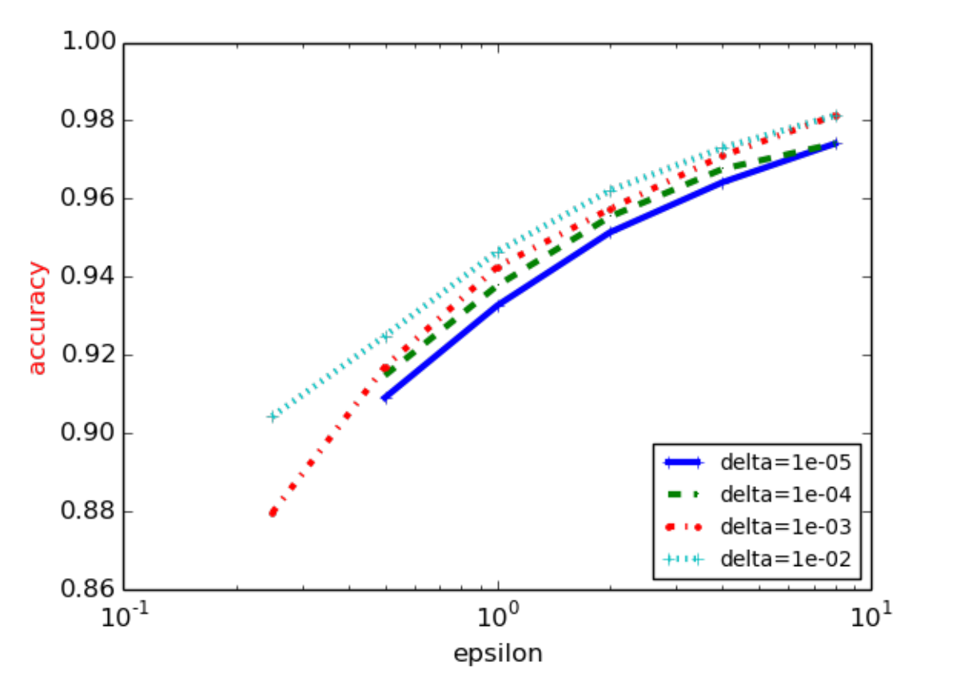
DP-SGD: Result for MNIST ²
ε = 0.5: 90% accuracy
ε = 8: 97% accuracy
² Abadi, Chu, Goodfellow, McMahan, Mironov, Talwar & Zhang: Deep Learning with Differential Privacy. CCS’16

Slide 212

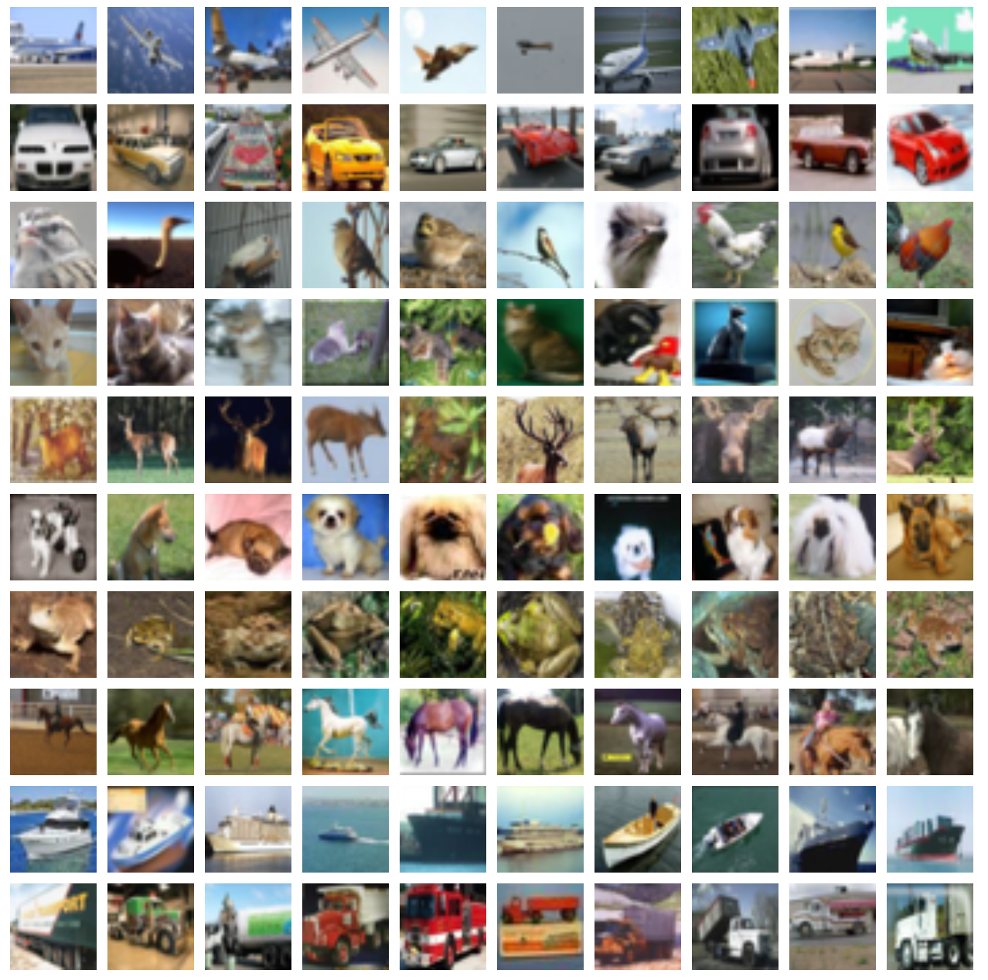
DP-SGD: Improving via Public Dataset
ImageNet Dataset
Public Dataset
Non-private training
E.g. public text dataset
Random initialization
Shared Embedding
E.g. user-generated text
CIFAR-10 Dataset
Sensitive Dataset
w₁
w₂
w₉
(x₁, y₁)
...
w₁₀
DP-SGD
w₁₁
...
w₁₂
(x_{n}, y_{n})

Slide 213
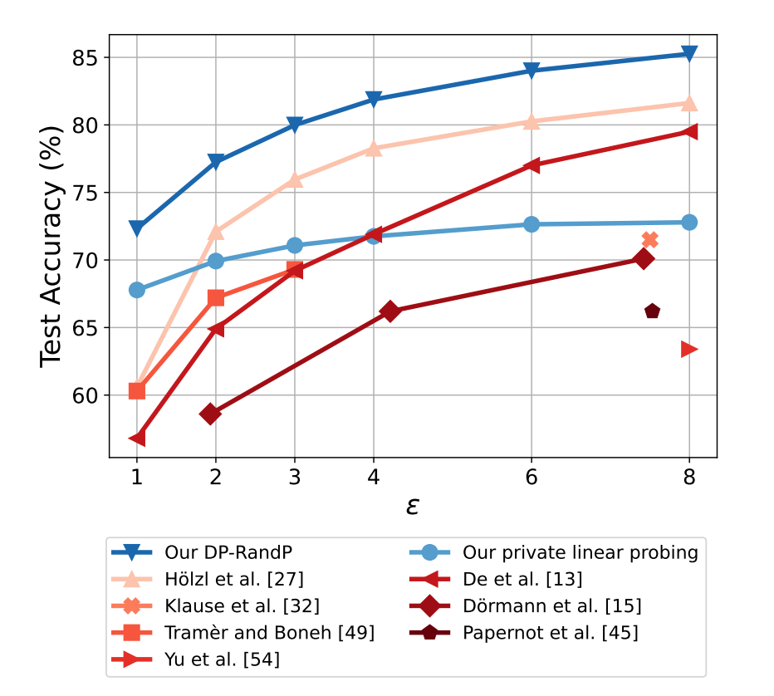
DP-SGD: Result for CIFAR-10 ³
ε = 1: 73% accuracy
ε = 8: 85% accuracy
³ Tang, Panda, Sehwag, Mittal: Differentially Private Image Classification by Learning Priors from Random Processes. 2023

Slide 214
Other ML Algorithms

Slide 215
Output Perturbation
“ERM + Gaussian Noise”
Output Perturbation
Theorem Under the two assumptions and with appropriate σ, Output Perturbation Mechanism is (ε, δ)-DP
w* ← argmin_{w} Σ_{i∈[n]} 𝓵(f_{w}(x_{i}), y_{i}) / n
Return w* + N(0, σ²⋅I)
Assumption I:
𝓵 is 𝞰-strongly convex
(i.e. 𝓵 - 0.5𝞰||w||² is convex)
Theorem w* has 𝓵₂-sensitivity ≤ 4L/𝞰n
Assumption II:
𝓵 is L-Lipschitz
(i.e. 𝓵’ ≤ L)

Slide 216
Objective Perturbation
“ERM but with perturbed objective”
Objective Perturbation
b ← N(0, σ²⋅I)
w* ← argmin_{w} Σ_{i∈[n]} 𝓵(f_{w}(x_{i}), y_{i}) / n + <b, w>
Return w*
Assumption I:
𝓵 is β-smooth
Theorem Under the two assumptions and with appropriate σ, Objective Perturbation Mechanism is (ε, δ)-DP
(i.e. gradient is β-Lipschitz)
Assumption II:
𝓵 is L-Lipschitz

Slide 217
Exponential Mechanism
Exponential Mechanism
Output each w with probability α exp(-0.5 ε ⋅ Σ_{i∈[n]} 𝓵(f_{w}(x_{i}), y_{i}))
Issue: Sampling cannot be done efficiently for general 𝓵
Assumption: Range(𝓵) ⊆ [0, 1]
Theorem When 𝓵 is convex, there is a poly
time sampling algorithm
Theorem Under the assumption, Exponential Mechanism is ε-DP

Slide 218
Other Properties of DP ML Algorithms

Slide 219
DP ⇒ Bounded Generalization Gap
“Theorem” If the model is trained with ε-DP, then (expected) generalization gap is O(ε)
Loss
Test Loss
Generalization Gap
Training Loss
Training Steps

Slide 220
DP ⇒ Replicability
Replicability
Dataset 1
Assumption: Same Distribution
Dataset 2
Algorithm M
Seed
Algorithm M
Model 1
The same w.h.p.
Model 2
“Theorem” If the model can trained with an ε-DP algorithm, then it can be trained with replicable algorithm (with comparable accuracy & # samples)

Slide 221
Conclusion

Slide 222
Conclusion
Privacy Attacks
ML models / Aggregated Statistic from Sensitive Data
Differentially Privacy
Formal protection against all attacks
Nice properties
Composition
Post processing
DP-SGD & Other DP ML algorithms

Slide 223
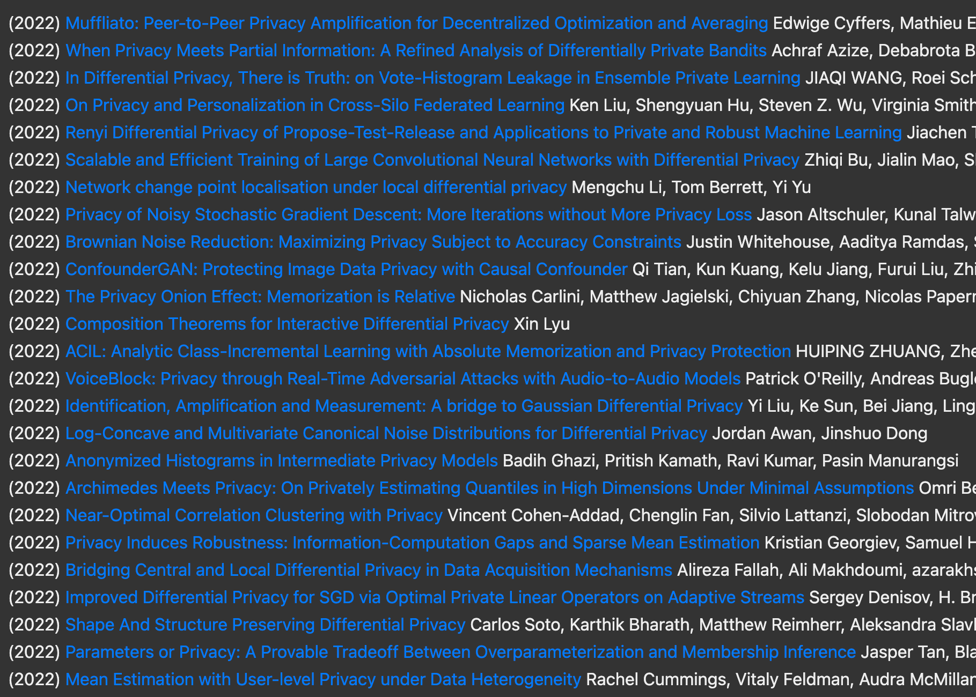
DP: Research Directions
Improving DP ML accuracies
Relaxation of Neighboring datasets, e.g. Label DP
Distributed Models of DP
Shuffle DP
Local DP
Federated Learning
Privacy Accounting
Privacy loss over time

Slide 224
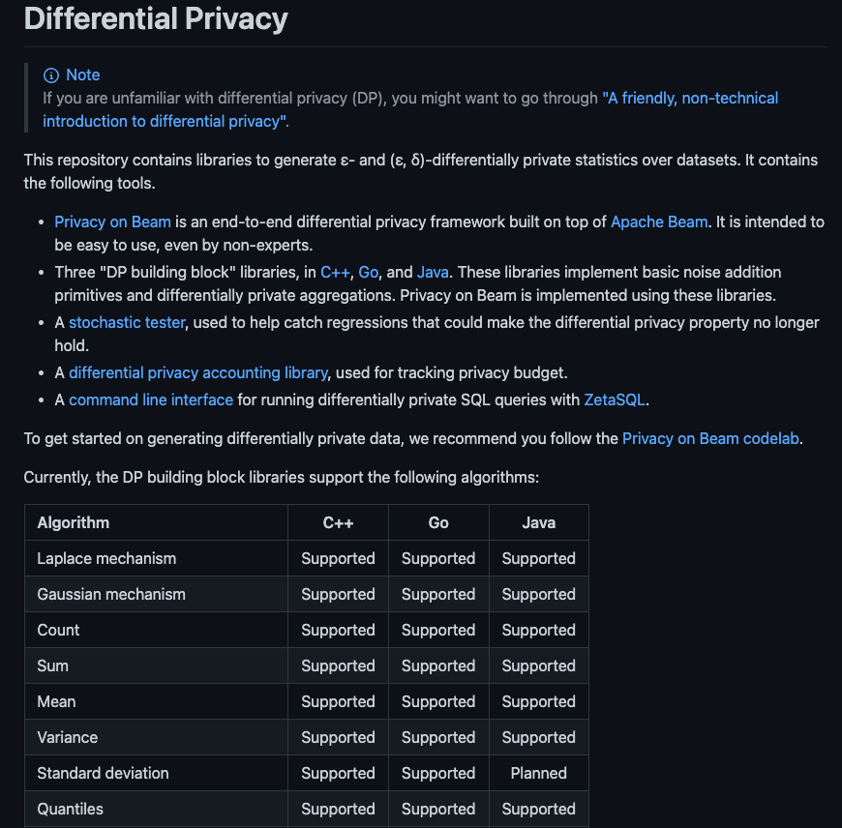
Open-Source Libraries
Some open-source DP libraries:
Generic DP Libraries:
Google DP Library
IBM Diffprivlib Library
OpenDP Library
DP ML Libraries:
Tensorflow privacy
Pytorch Opacus
github.com/google/differential-privacy

Slide 225
Parting Thoughts
Always think about privacy of the users
Even when we have consent, data must be used responsibly
Formal guarantees is preferred
E.g. DP
If not possible, then at least test against concrete attacks
Keep up-to-date with the literature
Thank you!

Slide 226
Appendix

Slide 227
Local DP

Slide 228
Model studied so far
X = (x₁, ..., x_{n})
Analyzer
Output
“Central DP”
Analyzer gets to see raw data
Undesirable if:
There is no trusted central authority
The analysis is done in distributed manner

Slide 229
Distributed Analytics
x₁
User 1
y₁
x₂
User 2
y₂
Analyzer
Estimate of f(x₁, x₂, …, x_{n})
...
x_{n}
User n
y_{n}

Slide 230
Differential Privacy: Central Model
(ε, δ)-Differential Privacy For all set S of outcomes, and two neighboring input datasets X, X’:
Pr[A(X) ∈ S] ≤ e^{ε}・Pr[A(X’) ∈ S] + δ
The output of the analyzer must be differentially private
x₁
User 1
y₁
x₂
User 2
y₂
Analyzer
Estimate of f(x₁, x₂, …, x_{n})
...
x_{n}
User n
y_{n}

Slide 231
Differential Privacy: Local Model [Kasiviswanathan et al.]
Each message has to be differentially private
(ε, δ)-Differential Privacy For all set S of outcomes, and two neighboring input datasets X, X’:
Pr[A(X) ∈ S] ≤ e^{ε}・Pr[A(X’) ∈ S] + δ
x₁
User 1
y₁
y₁
x₂
User 2
y₂
Analyzer
Estimate of f(x₁, x₂, …, x_{n})
...
x_{n}
User n
y_{n}

Slide 232
Distributed Analytics: Counting
x₁
User 1
y₁
x₂
User 2
y₂
Analyzer
Estimate of x₁ + x₂ + … + x_{n}
...
x_{n}
User n
y_{n}
∈
{0,1}

Slide 233
Counting with Central DP: Laplace Mechanism
x₁
User 1
y₁ = x₁
x₂
User 2
y₂ = x₂
Analyzer
x₁ + x₂ + … + x_{n} + Lap(1/ε)
...
ε-Central DP Algorithms: RMSE Ө(1/ε) by (discrete) Laplace Mechanism [Dwork et al.’06, Ghosh et al.’12]
x_{n}
User n
y_{n} = x_{n}
∈
{0,1}

Slide 234
Counting with Local DP: Laplace Mechanism
z₁, ..., z_{n} ~ Lap(1/ε)
x₁
User 1
y₁ = x₁ + z₁
Theorem Local Laplace Mechanism is ε-local DP
x₂
User 2
y₂ = x₂ + z₂
Analyzer
y₁ + ... + y_{n}
= x₁ + ... + x_{n} + z₁ + ... + z_{n}
...
How about the error?
x_{n}
User n
y_{n} = x_{n} + z_{n}
∈
{0,1}

Slide 235
Local Laplace Mechanism: Utility Analysis
Theorem Estimator from Local Laplace Mechanism has MSE 2n/ε²
RMSE = √(2n)/ε
Proof
MSE = 𝐄[(∑_{i∈[n]} y_{i} - ∑_{i∈[n]} x_{i})²]
= 𝐄[(∑_{i∈[n]} z_{i})²]
= ∑_{i∈[n]} 𝐄[z_{i}²]
= ∑_{i∈[n]} Var(z_{i})
= n (2/ε²)
QED

Slide 236
Randomized Response (RR) [Warner]
x_{i} with probability e^{ε}/(e^{ε}+1)
x₁
User 1
y₁
y_{i} =
y₁
1-x_{i} with probability 1/(e^{ε}+1)
x₂
User 2
y₂
...
Analyzer
x_{n}
User n
y_{n}
Theorem Randomized Response is ε-local DP
∈
{0,1}

Slide 237
Randomized Response (RR) [Warner]
x_{i} with probability e^{ε}/(e^{ε}+1)
x₁
User 1
y₁
y_{i} =
1-x_{i} with probability 1/(e^{ε}+1)
Theorem Randomized Response is ε-local DP
Proof
L_{M,X,X’}(o) = ln(Pr[M(X) = o] / Pr[M(X’) = o])
≤ ln((e^{ε}/(e^{ε}+1)) / (1/(e^{ε}+1)))
= ε
QED

Slide 238
Randomized Response (RR): Estimator
x_{i} with probability e^{ε}/(e^{ε}+1)
x₁
User 1
y₁
y_{i} =
1-x_{i} with probability 1/(e^{ε}+1)
x₂
User 2
y₂
Analyzer
???
...
x_{n}
User n
y_{n}
Theorem Randomized Response is ε-local DP
∈
{0,1}

Slide 239
Randomized Response (RR): Estimator
x_{i} with probability e^{ε}/(e^{ε}+1)
x₁
User 1
y₁
y_{i} =
1-x_{i} with probability 1/(e^{ε}+1)
x₂
User 2
y₂
Analyzer
y₁ + y₂ + … + y_{n}
...
Bad: If x₁ = ... = x_{n} = 0, then expected answer = n/(e^{ε}+1)
x_{n}
User n
y_{n}
∈
{0,1}

Slide 240
Randomized Response (RR): Estimator
x_{i} with probability e^{ε}/(e^{ε}+1)
x₁
User 1
y₁
y_{i} =
1-x_{i} with probability 1/(e^{ε}+1)
x₂
User 2
y₂
Analyzer
x̂₁ + x̂₂ + … + x̂_{n}
...
x_{n}
User n
y_{n}
Let x̂_{i} = (y_{i} - 1 / (e^{ε}+1) ) / (e^{ε}-1)
𝐄[x̂₁+...+x̂_{n}]
= x₁+...+x_{n}
∈
It is simple to verify that: 𝐄[x̂_{i}] = x_{i}
{0,1}

Slide 241
Randomized Response: Utility Analysis
Theorem Estimator from RR has MSE n e^{ε} / (e^{2ε} - 1)²
RMSE = O(√n/ε)
Proof
It is simple to verify that:
𝐄[x̂_{i}] = x_{i}
Var[x̂_{i}] = e^{ε} / (e^{2ε} - 1)²
Thus,
MSE = 𝐄[(∑_{i∈[n]} x̂_{i} - ∑_{i∈[n]} x_{i})²]
= ∑_{i∈[n]} 𝐄[(x̂_{i} - x_{i})²]
= ∑_{i∈[n]} Var(x̂_{i})
= n e^{ε} / (e^{2ε} - 1)²
QED

Slide 242
Advanced Topics:
Exponential Mechanisms

Slide 243
Back to the Central Model
(ε, δ)-Differential Privacy For all set S of outcomes, and two neighboring input datasets X, X’:
Pr[A(X) ∈ S] ≤ e^{ε}・Pr[A(X’) ∈ S] + δ
The output of the analyzer must be differentially private
x₁
User 1
y₁
x₂
User 2
y₂
Analyzer
Estimate of f(x₁, x₂, …, x_{n})
...
x_{n}
User n
y_{n}

Slide 244
Most Frequent Element
Each user has a subset of elements
Output: element that appears most frequently
Dataset
{linux, mac, windows}
ε-DP Algo
linux
...
{linux, windows}
Domain size = B
Baseline Algorithm
Exponential Mechanism: a solution that only “adds” O(log B / ε) noise!
Compute histogram + Laplace Noise
Lap(B / ε)^{⛒B}
𝓵₁-sensitivity = B

Slide 245
Median
Each user has a number in {1, ..., B}
Output:
the median
Dataset
Dataset X:
n/2 + 1 users have 1
n/2 - 1 users have B
1
ε-DP Algo
5
...
10
Dataset X’:
n/2 - 1 users have 1
n/2 + 1 users have B
Baseline Algorithm
Too noisy!
Compute median + Laplace Noise
Lap((B - 1) / ε)
sensitivity = B - 1

Slide 246
Abstraction: Selection Problem
Input: A set H of “candidates”
For each h ∈ H, score scr(h; X)∈ 𝐑 of h
Output: h* with approximately max score
Δ(scr)= Maximum sensitivity of scr(h;・) among all h
= max_{h∈H} max_{X≍X’} |scr(h;X) - scr(h;X’)|
Most Frequent Element
Median
H = set of all possible input values
scr(h; X) = - (difference between # of input elements below h and above h)
H = universe of all items
scr(h; X) = # times item h appears in X
Δ(scr)=1
Δ(scr)=2

Slide 247
Exponential Mechanism [McSherry-Talwar’07]
Input: A set H of “candidates”
For each h ∈ H, score scr(h; X)∈ 𝐑 of h
Output: h* with approximately max score
Δ(scr)= Maximum sensitivity of scr(h;・) among all h
= max_{h∈H} max_{X≍X’} |scr(h;X) - scr(h;X’)|
Exponential Mechanism (EM) [ McSherry-Talwar’07]
ε-DP algorithm such that, w.p. 0.99,
scr(h*; X) ≥ max_{h ∈ H} scr(h; X) - O(Δ(scr) ⋅ log |H| / ε)

Slide 248
Exponential Mechanism [McSherry-Talwar’07]
Differentially Private Selection
Examples
Most frequent element: score = # of times the element occurs
Median: score = difference between # of elements below h and above h
Input: A set H of “candidates”
For each h ∈ H, score scr(h; X)∈ 𝐑 of h
Output: h* with approximately max score
Comparison
Trivial solution: Compute the score for all candidate
𝓵₁-sensitivity: |H|・Δ(scr)
Add Laplace noise
⇒ Error per coordinate Δ(scr)・|H| / ε
Exponential Mechanism (EM) [ McSherry-Talwar’07]
ε-DP algorithm such that, w.p. 0.99,
scr(h*; X) ≥ max_{h ∈ H} scr(h; X) - O(Δ(scr) ⋅ log |H| / ε)
Maximum sensitivity of scr(h;・) for fixed h

Slide 249
Exponential Mechanism
Exponential Mechanism (EM)
Output each h ∈ H with probability
∝ exp(0.5ε ⋅ scr(h; X) / Δ(scr))

Slide 250
Exponential Mechanism: Privacy Proof
Exponential Mechanism (EM)
Observation For any X≍X’, h, we have
exp(scr(h; X)/b) ≤e^{ε/2}⋅exp(scr(h; X’)/b),
Z(X’)≤e^{ε/2}⋅Z(X)
Output each h ∈ H with probability
exp(scr(h; X)/b)/Z(X) where b = 2Δ(scr)/ε
and Z(X) = ∑_{h’∈ H}exp(scr(h; X) / b)
Theorem Exponential Mechanism is ε-DP.
Proof
For all X≍X’, h ∈ H,
L_{M,X,X’}(o) = ln(Pr[M(X) = h] / Pr[M(X’) = h])
= ln(exp(scr(h; X)/b) / exp(scr(h; X’)/b)) + ln(Z(X’) / Z(X))
≤ ε / 2 + ε / 2
= ε
(Observation)
QED

Slide 251
Exponential Mechanism: Utility Proof
Exponential Mechanism (EM)
Theorem With probability 0.99, EM output h* such that scr(h*; X)
≥ max_{h ∈ H}scr(h; X) - 10b ⋅ log |H|
Output each h ∈ H with probability
exp(scr(h; X)/b)/Z(X) where b = 2Δ(scr)/ε
and Z(X) = ∑_{h’∈ H}exp(scr(h; X) / b)
Proof
Let scr* = max_{h ∈ H}scr(h; X) and H_{bad} = {h’ | scr(h’; X) < scr* - 10b ⋅ log |H|}.
Pr[EM outputs element of H_{bad}] = ∑_{h’∈ H} exp(scr(h’; X)/b) / Z(X)
_{bad}

Slide 252
Exponential Mechanism: Utility Proof
Exponential Mechanism (EM)
Theorem With probability 0.99, EM output h* such that scr(h*; X)
≥ max_{h ∈ H}scr(h; X) - 10b ⋅ log |H|
Output each h ∈ H with probability
exp(scr(h; X)/b)/Z(X) where b = 2Δ(scr)/ε
and Z(X) = ∑_{h’∈ H}exp(scr(h; X) / b)
Proof
Let scr* = max_{h ∈ H}scr(h; X) and H_{bad} = {h’ | scr(h’; X) < scr* - 10b ⋅ log |H|}.
Pr[EM outputs element of H_{bad}] = ∑_{h’∈ H} exp(scr(h’; X)/b) / Z(X)
≤ ∑_{h’∈ H} exp(scr(h’; X)/b) / exp(scr*/b)
_{bad}
_{bad}

Slide 253
Exponential Mechanism: Utility Proof
Exponential Mechanism (EM)
Theorem With probability 0.99, EM output h* such that scr(h*; X)
≥ max_{h ∈ H}scr(h; X) - 10b ⋅ log |H|
Output each h ∈ H with probability
exp(scr(h; X)/b)/Z(X) where b = 2Δ(scr)/ε
and Z(X) = ∑_{h’∈ H}exp(scr(h; X) / b)
Proof
Let scr* = max_{h ∈ H}scr(h; X) and H_{bad} = {h’ | scr(h’; X) < scr* - 10b ⋅ log |H|}.
Pr[EM outputs element of H_{bad}] = ∑_{h’∈ H} exp(scr(h’; X)/b) / Z(X)
≤ ∑_{h’∈ H} exp(scr(h’; X)/b) / exp(scr*/b)
≤ ∑_{h’∈ H} exp(-10 ⋅ log |H|)
_{bad}
_{bad}
_{bad}

Slide 254
Exponential Mechanism: Utility Proof
Exponential Mechanism (EM)
Theorem With probability 0.99, EM output h* such that scr(h*; X)
≥ max_{h ∈ H}scr(h; X) - 10b ⋅ log |H|
Output each h ∈ H with probability
exp(scr(h; X)/b)/Z(X) where b = 2Δ(scr)/ε
and Z(X) = ∑_{h’∈ H}exp(scr(h; X) / b)
Proof
Let scr* = max_{h ∈ H}scr(h; X) and H_{bad} = {h’ | scr(h’; X) < scr* - 10b ⋅ log |H|}.
Pr[EM outputs element of H_{bad}] = ∑_{h’∈ H} exp(scr(h’; X)/b) / Z(X)
≤ ∑_{h’∈ H} exp(scr(h’; X)/b) / exp(scr*/b)
≤ ∑_{h’∈ H} exp(-10 ⋅ log |H|)
≤ ∑_{h’∈ H} 0.01 / |H|
_{bad}
_{bad}
_{bad}
_{bad}

Slide 255
Exponential Mechanism: Utility Proof
Exponential Mechanism (EM)
Theorem With probability 0.99, EM output h* such that scr(h*; X)
≥ max_{h ∈ H}scr(h; X) - 10b ⋅ log |H|
Output each h ∈ H with probability
exp(scr(h; X)/b)/Z(X) where b = 2Δ(scr)/ε
and Z(X) = ∑_{h’∈ H}exp(scr(h; X) / b)
Proof
Let scr* = max_{h ∈ H}scr(h; X) and H_{bad} = {h’ | scr(h’; X) < scr* - 10b ⋅ log |H|}.
Pr[EM outputs element of H_{bad}] = ∑_{h’∈ H} exp(scr(h’; X)/b) / Z(X)
≤ ∑_{h’∈ H} exp(scr(h’; X)/b) / exp(scr*/b)
≤ ∑_{h’∈ H} exp(-10 ⋅ log |H|)
≤ ∑_{h’∈ H} 0.01 / |H|
≤ 0.01
_{bad}
_{bad}
_{bad}
_{bad}
QED

Slide 256
Advanced Topics:
Shuffle Model

Slide 257
Recall: Central Model
(ε, δ)-Differential Privacy For all set S of outcomes, and two neighboring input datasets X, X’:
Pr[A(X) ∈ S] ≤ e^{ε}・Pr[A(X’) ∈ S] + δ
The output of the analyzer must be differentially private
x₁
User 1
y₁
x₂
User 2
y₂
Analyzer
Estimate of f(x₁, x₂, …, x_{n})
...
x_{n}
User n
y_{n}

Slide 258
Differential Privacy: Local Model [Kasiviswanathan et al.]
Each message has to be differentially private
(ε, δ)-Differential Privacy For all set S of outcomes, and two neighboring input datasets X, X’:
Pr[A(X) ∈ S] ≤ e^{ε}・Pr[A(X’) ∈ S] + δ
x₁
User 1
y₁
y₁
x₂
User 2
y₂
Analyzer
Estimate of f(x₁, x₂, …, x_{n})
...
x_{n}
User n
y_{n}

Slide 259
Differential Privacy: Shuffled Model [Bittau et al., Erlingsson et al.]
π
Shuffled messages have to be differentially private
☰
Multiset of messages have to be differentially private
x₁
User 1
y₁
y_{π(1)}
Anonymous Model [Ishai et al.]
Encode-Shuffle-Analyze Architecture [Bittau et al.]
Shuffled/Shuffle Model [Cheu et al., Erlingsson et al.]
x₂
User 2
y₂
y_{π(2)}
Analyzer
...
Amplification by Shuffling (Informal) [Erlingsson et al., Balle et al., Feldman et al.]
Any ε_{L}-local DP algorithm is (ε, δ)-shuffled DP for ε ≪ ε_{L} and for reasonable value of δ.
x_{n}
User n
y_{n}
y_{π(n)}

Slide 260
Shuffled Model: Multi-Message Setting
π
y₁¹
y_{π(1)}
x₁
User 1
...
y_{π(2)}
y₁^{d}
¹
y₂¹
Estimate of x₁ + x₂ + … + x_{n}
x₂
User 2
Analyzer
...
y₂^{d}
²
...
...
y_{n}¹
x_{n}
User n
Shuffled messages have to be differentially private
...
y_{n}^{d}
y_{π(M)}
^{n}
M = d₁ + … +d_{n}

Slide 261
DP Summation in Shuffle Model
Single-Message
Multi-Message: Split-and-Mix Protocol [Balle et al.’19]
Randomizer:
Randomizer:
y₁
x
User
y = x + Noise
x
User
z = x + Noise
...
y_{m-1}
Analyzer: Just sum all messages up!
y_{m}
y₁, …, y_{m} randomly selected so that y₁ + … + y_{m} = z
Benefit over Local DP: Amplification by Shuffling
As good accuracy as central DP!

Slide 262
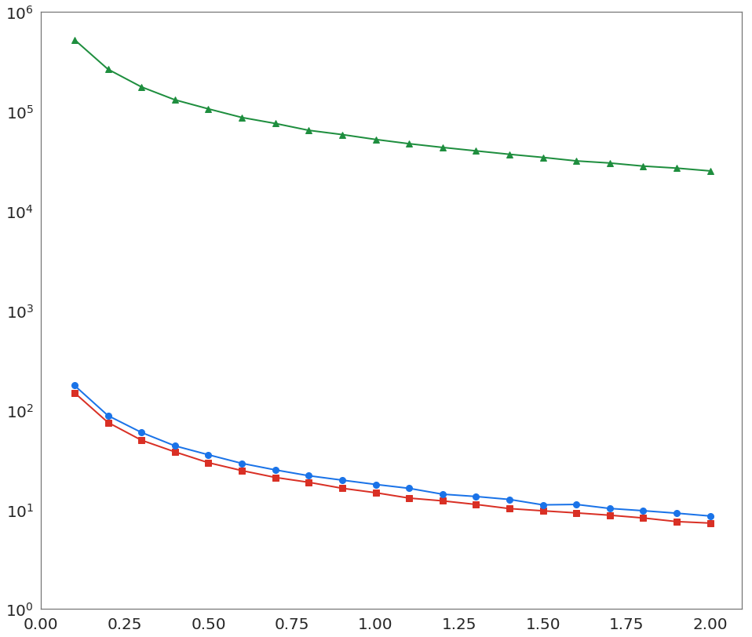
DP Summation in Shuffle Model
Experiment (IPUMS 1940 City Dataset)
Multi-Message: Split-and-Mix Protocol [Balle et al.’19]
Parameters: n ≈ 60M, B = 915, ẟ = 2 * 10⁻⁹
Randomizer:
y₁
Local
x
User
z = x + Noise
...
y_{m-1}
y_{m}
max error
y₁, …, y_{m} randomly selected so that y₁ + … + y_{m} = z
Shuffled
Central
As good accuracy as central DP!
𝝴

Slide 263
Advanced Topics:
Privacy Accounting

Slide 264
Basic Composition
(ε₁, δ₁)-DP Algo
Output 1
Dataset
User 1
(ε₂, δ₂)-DP Algo
Output 2
...
User n
...
(ε_{k}, δ_{k})-DP Algo
Output k
Basic Composition Theorem [Dwork et al.]
All the outputs combined remain (ε₁+ε₂+...+ε_{k}, δ₁+δ₂+...+δ_{k})-DP

Slide 265
Advanced Composition
(ε, δ)-DP Algo
Output 1
Dataset
User 1
(ε, δ)-DP Algo
Output 2
...
User n
...
(ε, δ)-DP Algo
Output k
Advanced Composition Theorem [Dwork et al.]
All the outputs combined is (ε’, kδ + δ’)-DP where
ε’ =
Can be improved for specific algorithms!

Slide 266
Amplification by Subsampling
“Subsampling makes the algorithm more private.”
Sample B-out-of-n users randomly
Dataset
Dataset
Substitution DP
User 1
User 3
(ε, δ)-DP Algo
Output
...
...
User n
User n - 5
Substitution DP
Amplification-by-subsampling Theorem
The output combined is (ε’, δ’)-DP where
ε’ = ln(1 + p(e^{ε} - 1)), δ’ = pδ
with p = B / n.
Can be improved for specific algorithms!

Slide 267
Renyi-DP [Abadi et al’16, Mironov’17]
Renyi-DP (RDP)
A mechanism M is (α, ρ)-RDP if, for all neighboring datasets X, X’,
D_{α}(M(X)||M(X’)) ≤ ρ
where D_{α}(P||Q) denotes the α-Renyi divergence.
D_{α}(P||Q) = E_{x~P} [(P(x)/Q(x))^{α-1}] / (α-1)
RDP ⇒ DP Conversion
(α, ρ)-RDP ⇒ (ε, δ)-DP for
δ = e^{(α-1)(αρ - ε)} ⋅ (1 - 1/α)^{α} / (α-1)
Differential Privacy (DP)
M is ε-DP if it is (∞, ε)-RDP.

Slide 268
RDP Composition
(α, ρ₁)-RDP Algo
Output 1
Dataset
User 1
(α, ρ₂)-RDP Algo
Output 2
...
User n
...
(α, ρ_{k})-RDP Algo
Output k
RDP Composition Theorem [Mironov]
All the outputs combined remain (α, ρ₁+ρ₂+...+ρ_{k})-RDP
Can be translated to DP using formula from previous slide
Also some RDP bounds on amplification-by-subsampling

Slide 269
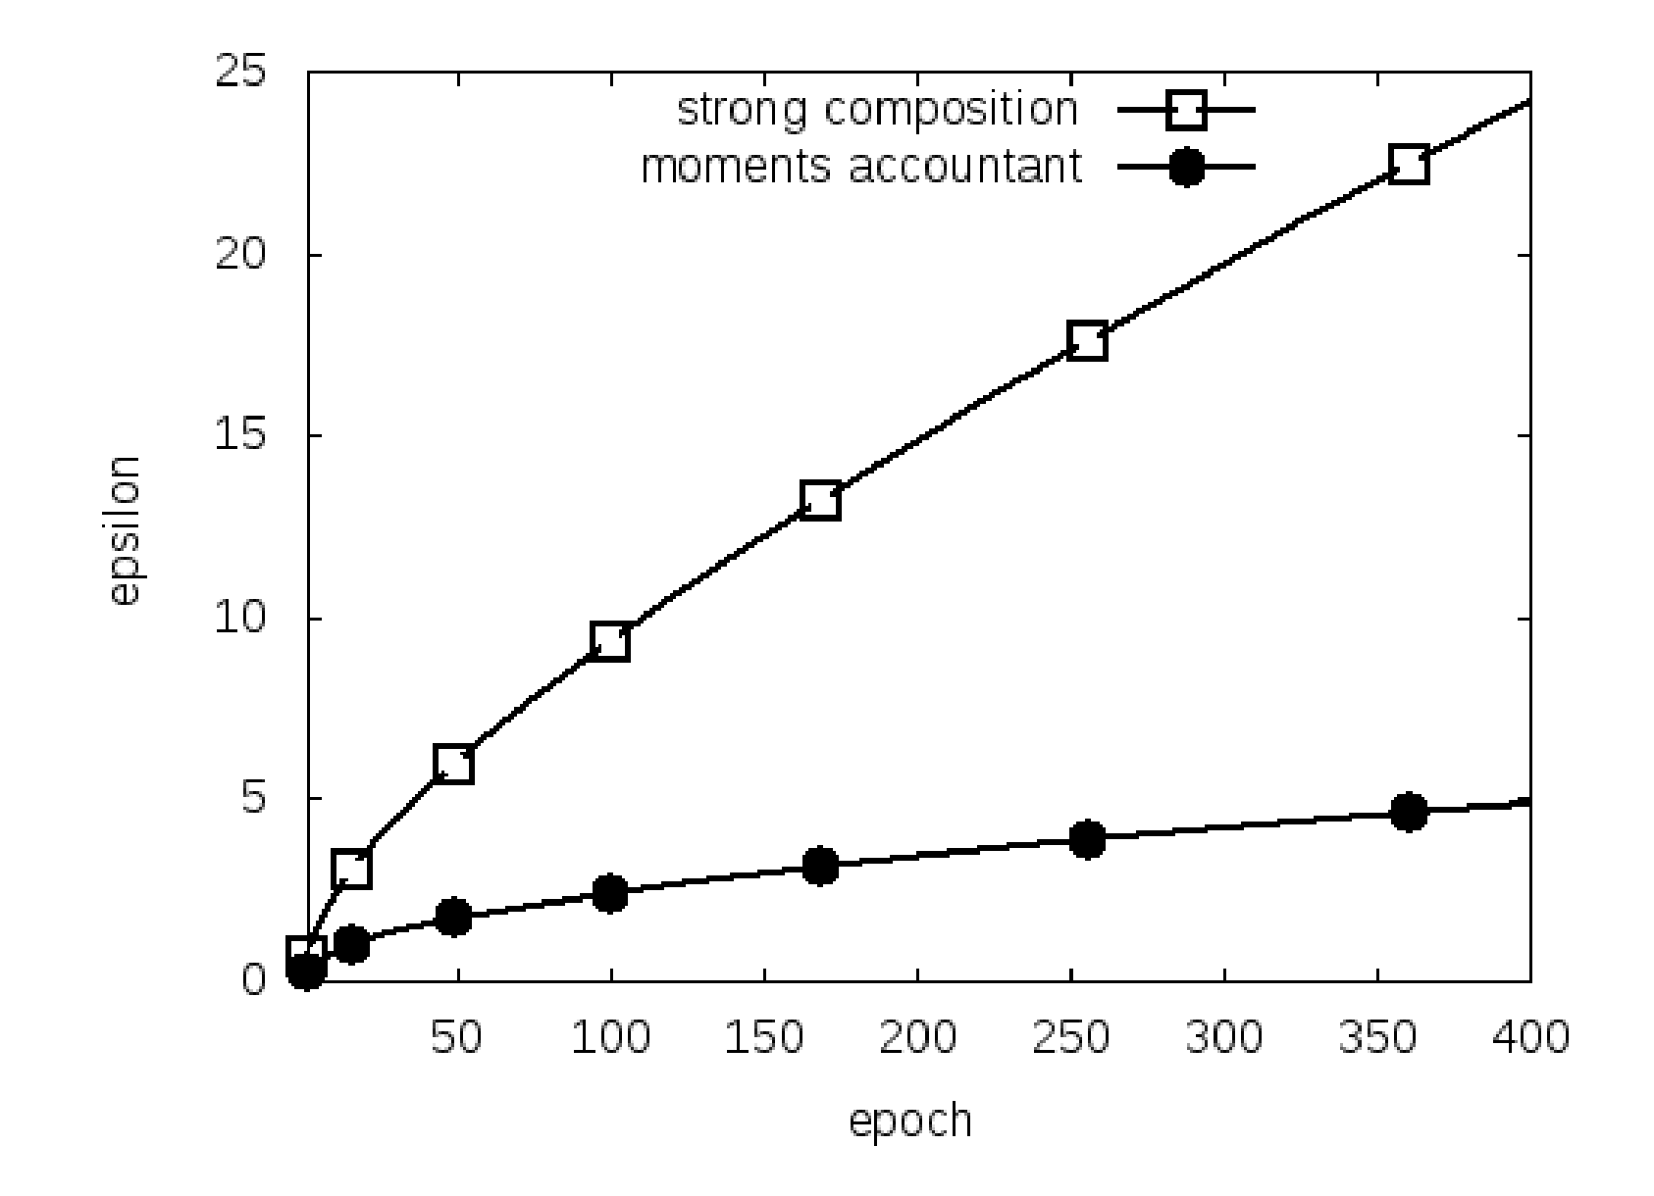
RDP vs Advanced Composition (DP-SGD)
Abadi et al.: Deep Learning with Differential Privacy. CCS’16

Slide 270
Privacy Loss Distribution (PLD)
Discrete outputs
Continuous outputs
Privacy Loss
For M, X, X’, the privacy loss at output o is
L_{M,X,X’}(o) = ln(Pr[M(X) = o] / Pr[M(X’) = o])
Privacy Loss
For M, X, X’, the privacy loss at output o is
L_{M,X,X’}(o) = ln(f_{M(X)}(o) / f_{M(X’)}(o))
Privacy Loss Distribution
PLD_{M,X,X’} is the distribution of L_{M,X,X’}(o) where o~M(X)
Tight composition theorems by tracking the PLD!
Pure-DP Condition
M is ε-DP iff, for all X≍X’, o ∈ Range(M),
L_{M,X,X’}(o) ≤ ε
Approximate-DP Condition
M is (ε, δ)-DP iff, for all X≍X’,
𝐄_{y}[ [1 - e^{ε-y}]₊ ] ≤ δ
where y ~ PLD_{M,X,X’} and [a]₊ := max{a, 0}

Slide 271
PLD Composition*
Algo with PLD₁
Output 1
Dataset
User 1
Algo with PLD₂
Output 2
...
User n
...
Algo with PLD_{k}
Output k
PLD Composition Theorem [Dwork et al.]
PLD of all the outputs combined is the convolution of PLD₁, ..., PLD_{k}

Slide 272
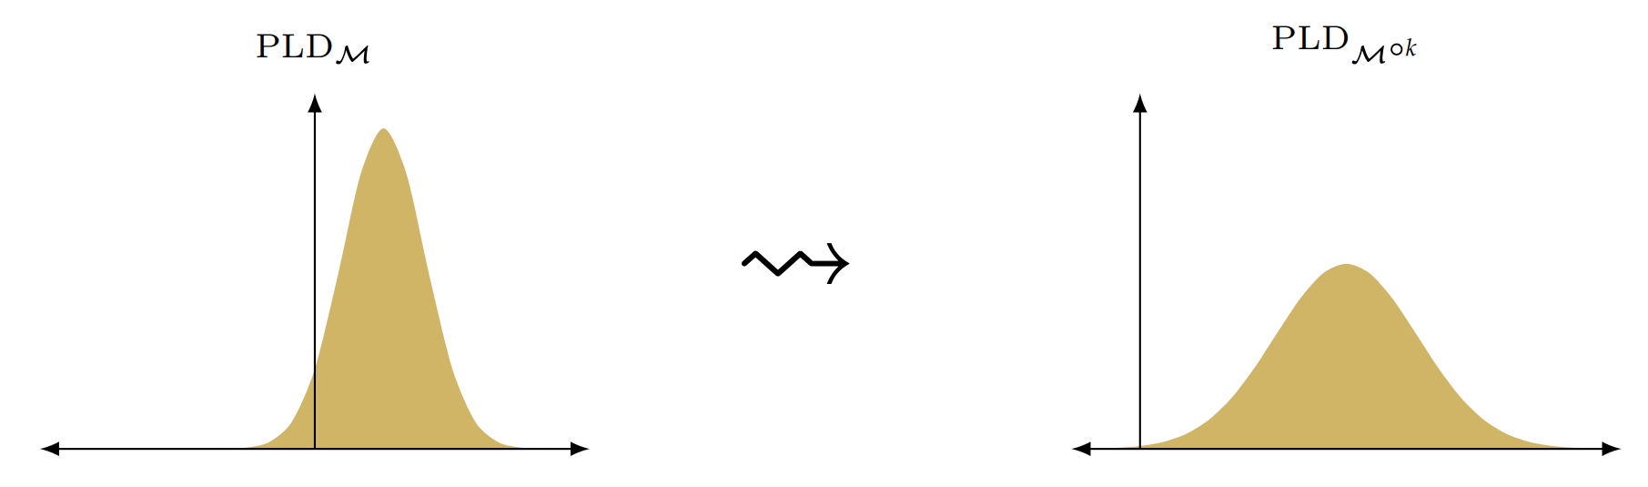
PLD: Examples
PLD after k-fold composition
M: Gaussian Mechanism
PLD: Also a Gaussian!
k-convolution
Issue: can’t represent continuous distributions...

Slide 273
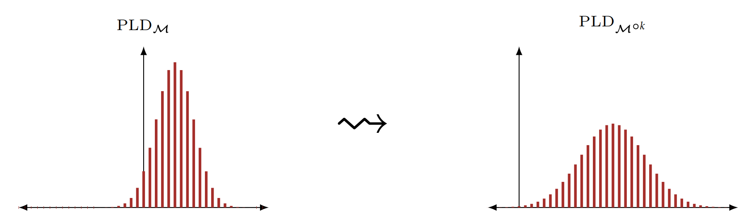
PLD: Examples
PLD after k-fold composition
M: Gaussian Mechanism
PLD: Also a Gaussian!
k-convolution
Issue: can’t represent continuous distributions...
Solution: discretize!
k-convolution
Active Research:
Discretization methods
Error Bounds
Fast fourier transform!

Slide 274
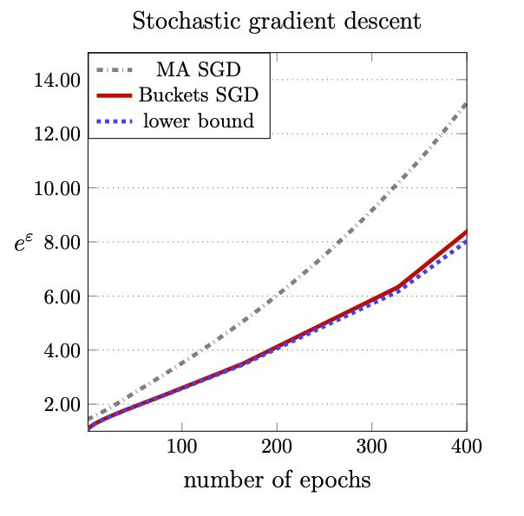
PLD vs RDP
Meiser & Mohammadi: Tight on Budget? Tight Bounds for r-Fold Approximate Differential Privacy. CCS’18

Slide 275
Advanced Topics:
Side-Channel Attacks

Slide 276
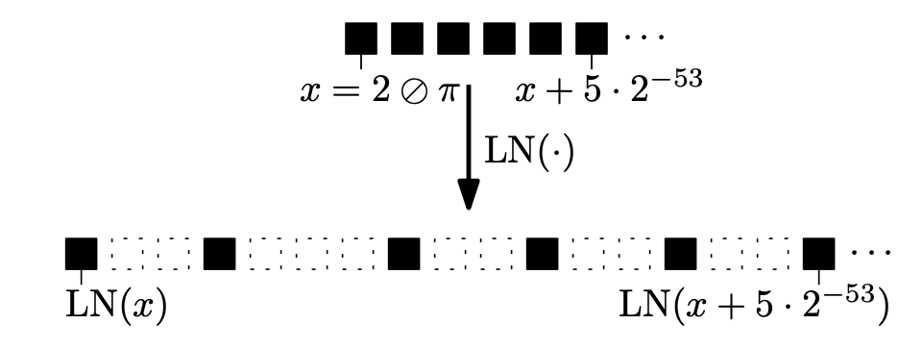
Side-Channel Attacks
Laplace distribution sampling in practice:
Involves taking log of uniform [0, 1] random variable
Taking log creates “holes”
Can distinguish D, D’ if g(D), g(D’) have different least significant bits!
Mironov: On Significance of the Least Significant Bits For Differential Privacy. CCS’12

Slide 277
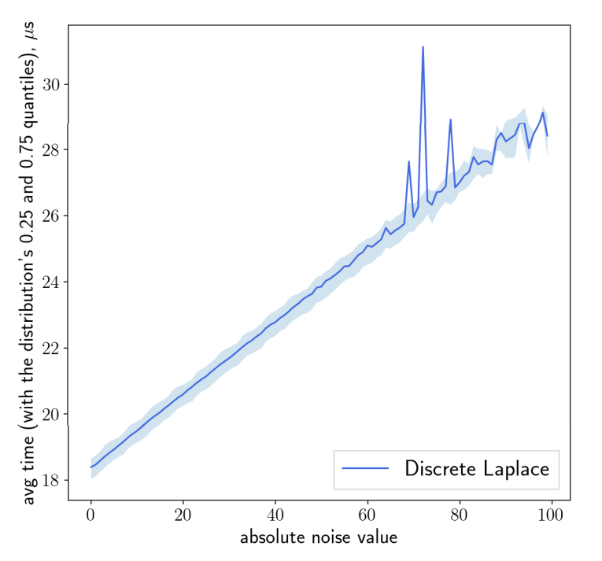
Side-Channel Attacks (cont)
Timing attack:
Laplace noise sampling
Longer time ⇒ Larger Noise
Launching the attack:
Observing algorithm running time
⇒ can approximate the noise
⇒ subtract the approximate noise
Jin et al.: Are We There Yet? Timing and Floating-Point Attacks on Differential Privacy Systems. S&P’22

